Slide 1
Cold War Propaganda

Slide 2
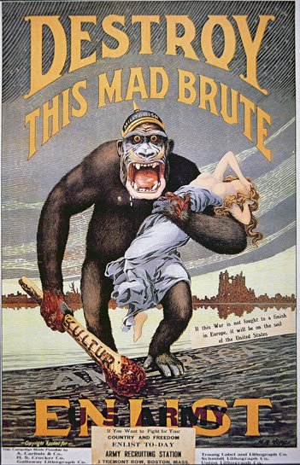
Common Tools in Wartime Propaganda
Demonization = portraying the enemy as purely evil, menacing, murderous, and aggressive.

Slide 3
Common Tools in Wartime Propaganda
Emotional Appeals = playing on people’s emotions to promote the war effort (mostly through fear)

Slide 4
Common Tools in Wartime Propaganda
Name Calling = Using loaded labels to encourage hatred of the enemy
“Commies”
“Japs”
“Huns”

Slide 5
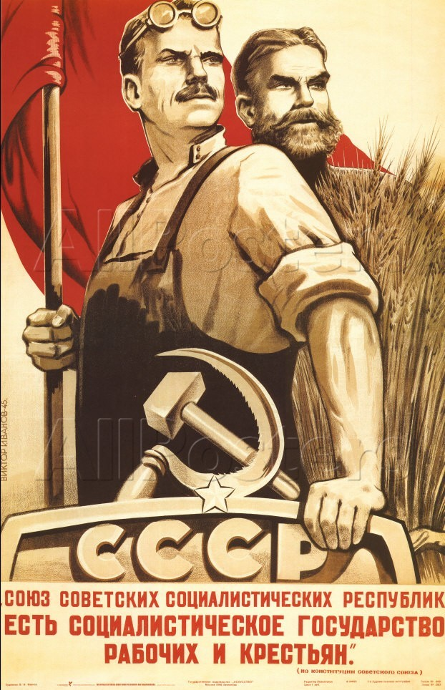
Common Tools in Wartime Propaganda
Patriotic Appeals = Using patriotic language or symbols to appeal to a people’s national pride

Slide 6
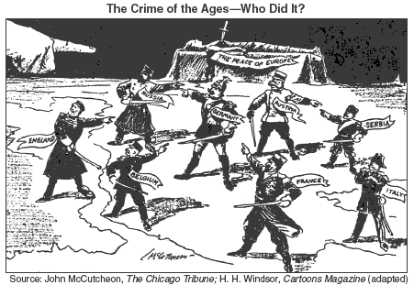
Common Tools in Wartime Propaganda
Half-Truths or Lies = the inclusion of some element of truth to make an argument more persuasive
Example = blaming the enemy for complete responsibility for the war

Slide 7
Common Tools in Wartime Propaganda
Catchy Slogans = Using memorable phrases to foster support for the war effort
Example = Remember the Alamo!

Slide 8
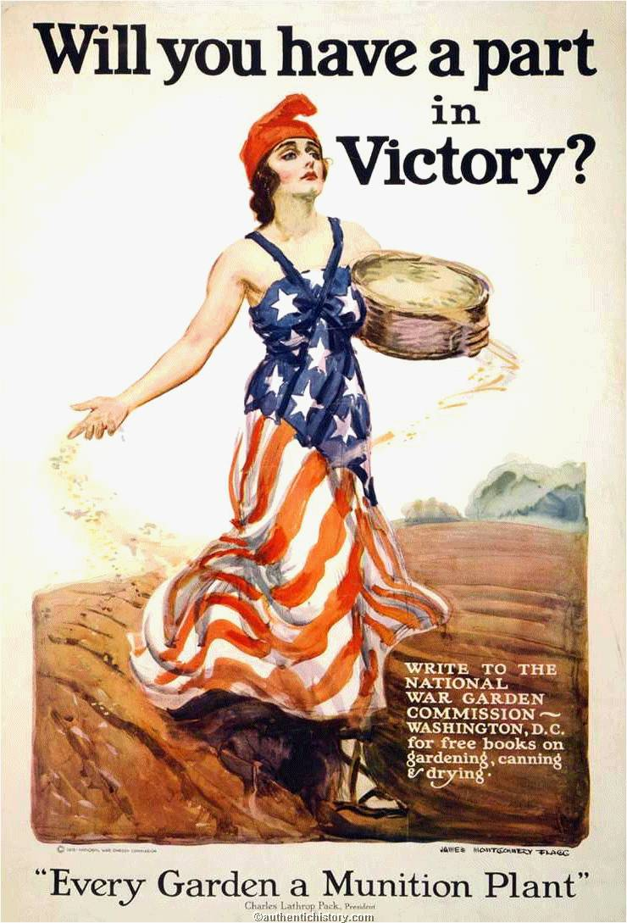
Common Tools in Wartime Propaganda
Visual Symbols = using symbols that appeal to people’s emotions (flags, statues, mothers and children, enemy uniforms, etc.) to promote the war effort

Slide 9
Common Tools in Wartime Propaganda
Humor or Caricatures = capturing the viewer’s attention through the use of humor. The enemy is almost always the butt of the jokes.

Slide 10
Propaganda Analysis Worksheet
As a class, we are going to analyze a piece of Cold War propaganda using the worksheet provided.

Slide 11
Propaganda
1. Message
Draw arrows to the visual elements that communicate the message.
Visual cues:
What is the message?

Slide 12
Propaganda
2. Context
What are the hopes, fears, and grievances present in society at this time?
Given that climate, why might this message have had power?

Slide 13
Propaganda
3. Audience
Who is the target audience? What about this message would be appealing to this group? What reactions might different audiences have had? Could people access and express alternative viewpoints?

Slide 14
Propaganda
4. Creator
Who is the propagandist?
What do they hope the audience will…
Think:
Feel:
Do:

Slide 15
Propaganda
5. Consequences
What effects could this message have on society?

Slide 16
Instructions for the Brochures
Using the instructions sheet I give you, you will create a trifold propaganda brochure using Canva/Piktochart/Thinglink or hand-drawing about The Soviet Union
The brochures are due next class
You can write a propaganda brochure (using appropriate slang and terminology) about one of the following topics:
The Berlin Airlift/Wall
The Space Race
Communism
Stalin (cult of personality)
The evils of America
The glory of the Soviet Union and why everyone should join it
A travel guide to visiting your communist friend in Cuba (Fidel Castro)
The testing of the hydrogen bomb (visitor’s guide)

