Slide 1
Cuban Revolution and the Missile Crisis

Slide 2
Notebook Instructions
On page 21, please write Day 1 at the top
Please write down the warmup question and answer
See Miss Caspers’ notebook for reference

Slide 3
Warmup
How difficult was the manifesto to create? What was easy? What was difficult? Why?

Slide 4
Running List
Please add the following terms to your running list:
Cuban Missile Crisis
Cuban Revolution
Bay of Pigs

Slide 5
Notebook Instructions
On page 22, please write Day 5 “The Century: Poisoned Dreams” at the top
On page 23, please write Day 5 The Cuban Revolution and Missile Crisis Notes

Slide 6
Background: Cuban Revolution
In 1959, Fidel Castro overthrew the US-backed Cuban government under President Fulgencio Batista and set up a communist regime
Cuba is just 90 miles from US!
The CIA began training Cuban exiles to invade the island and lead a revolution against Castro
Kennedy did not plan any of this (before he was President)
Kennedy did approve of the mission when it came time to launch

Slide 7
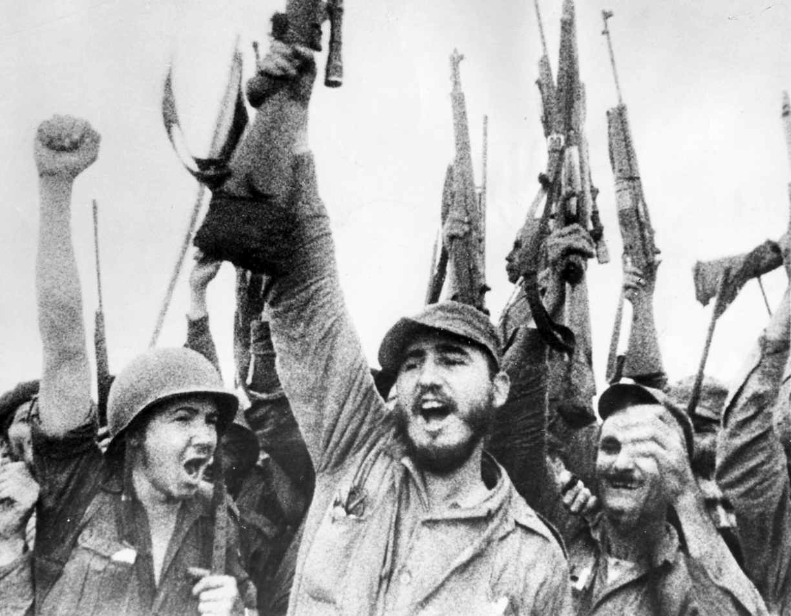
Fidel Castro

Slide 8
Cuban Missile Crisis
1) Please read the articles titled “October 1962: Kennedy Discovers the Missiles” and “Letter from Prime Minister Castro to Chairman Khrushchev, October 26, 1962”
2) After you have finished reading, using my laptops you will watch 3 videos titled “Be Kennedy”, “Be Khruschev”, and “Be Castro” (YouTube) and fill out the chart
3) Read the “Aftermath” Article when you are finished
4) Paste the packet onto page 23 of your notebook

