Slide 1
October 14 and 15
Today, we will learn about the dynasties and achievements of ancient China.

Slide 2
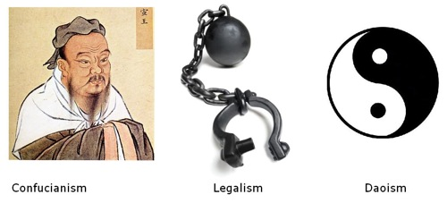
Confucianism, Taoism and Legalism

Slide 3
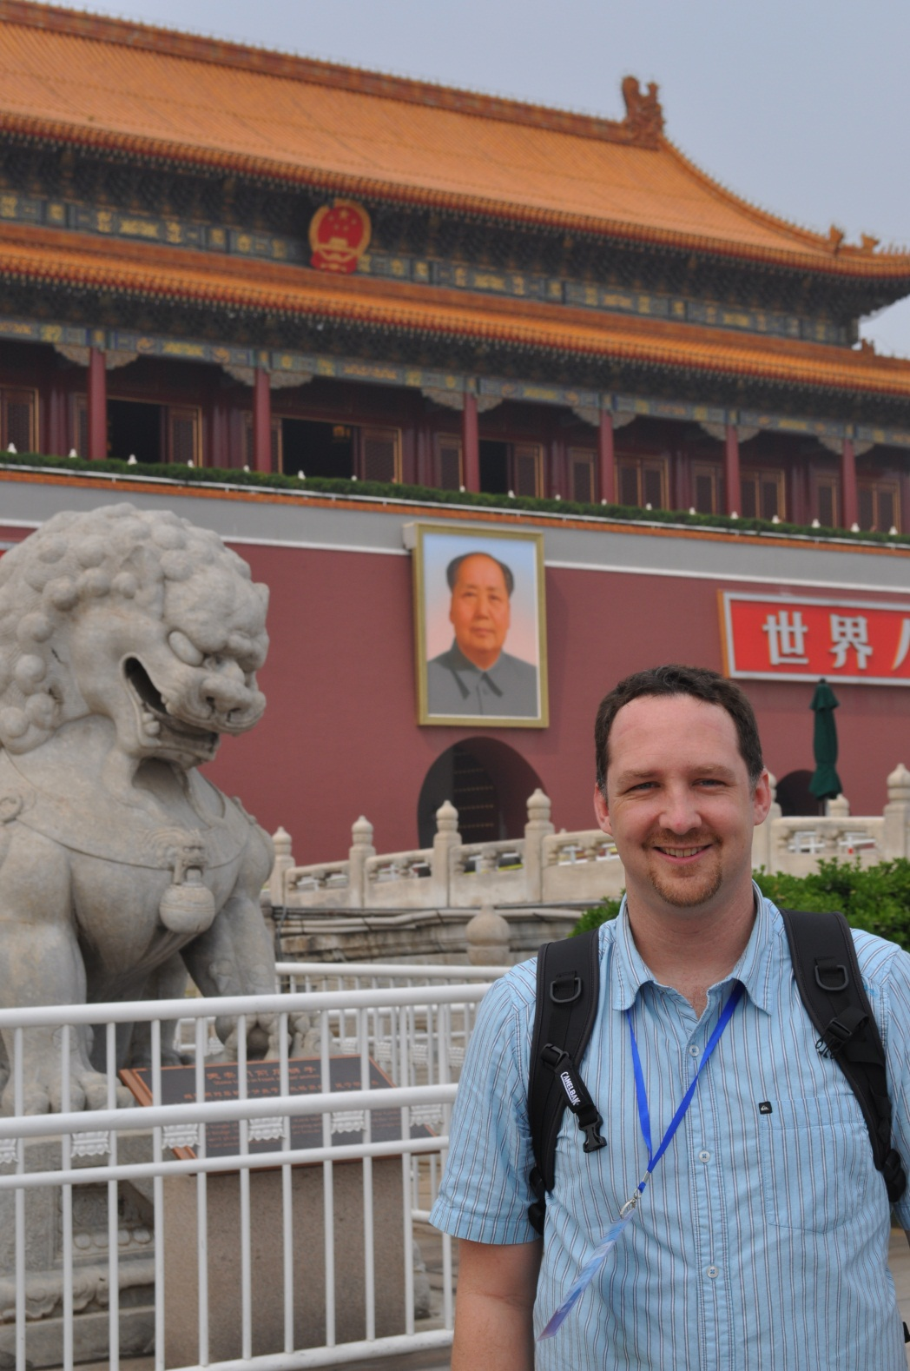
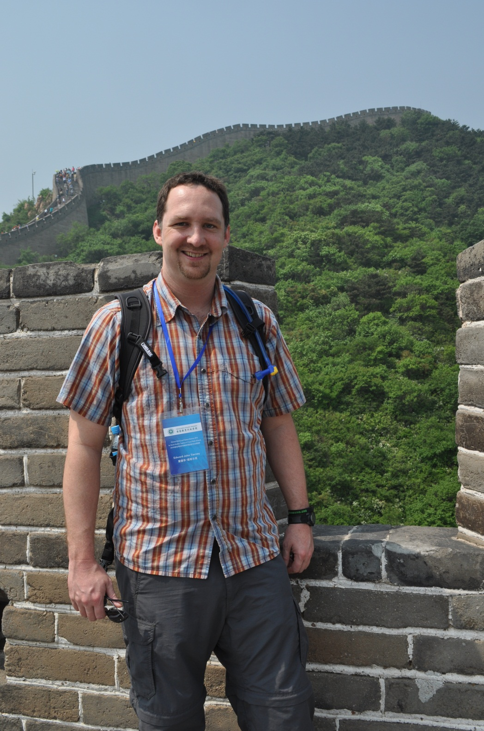

Slide 4
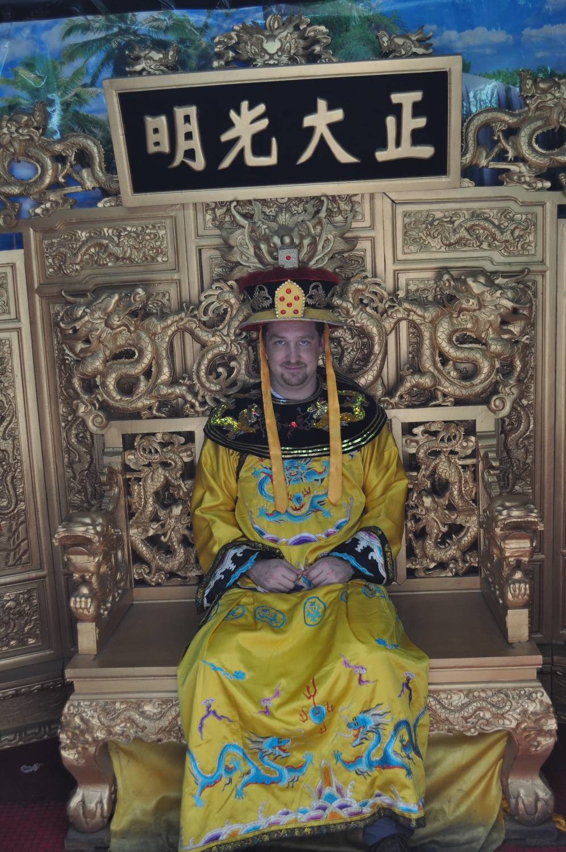
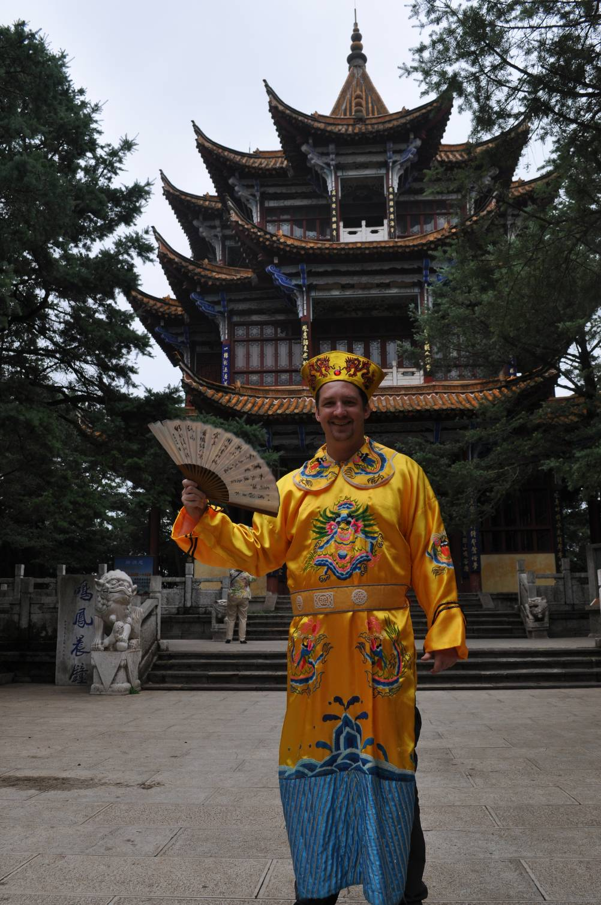

Slide 5
Label a page “Dynasties of China”
Draw a big circle
taking up the whole page,
divide it in four
quadrants.

Slide 6
Chinese Dynastic Cycle
Rise: a leader defeats enemies and establishes a dynasty
Peak: internal peace, expansion and great power; uses wealth to improve life for people
Decline: raise taxes for benefit of wealthy, unable to defend borders
Collapse/Civil War: dynasty collapses into civil war

Slide 7
Get charts titled:
“Dynasties of Ancient and Medieval China” and “Notable Individuals.”
Fill in notes on the chart as we go.

Slide 8
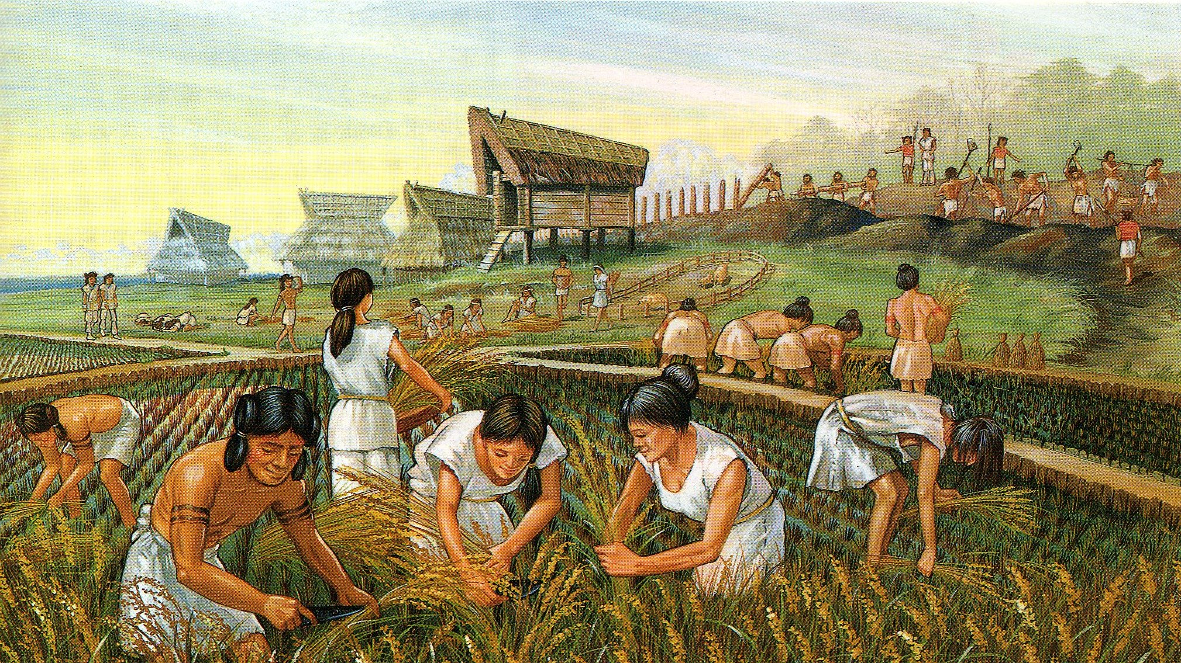
Early Dynasties (2000 BCE – 202 BCE)
Xia Dynasty (2000 BCE- 1532): developed agriculture and cities in China, cultivating rice and making silk

Slide 9
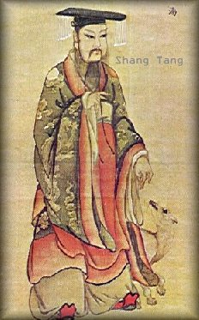
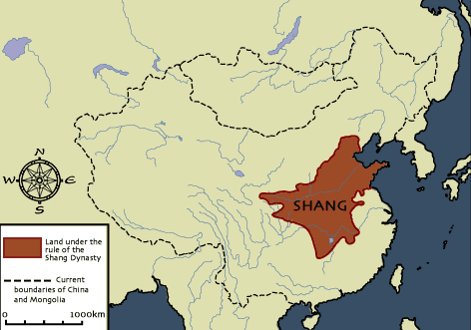
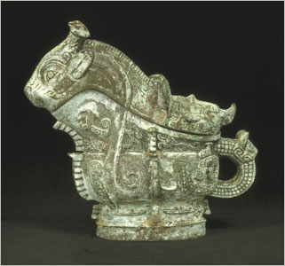
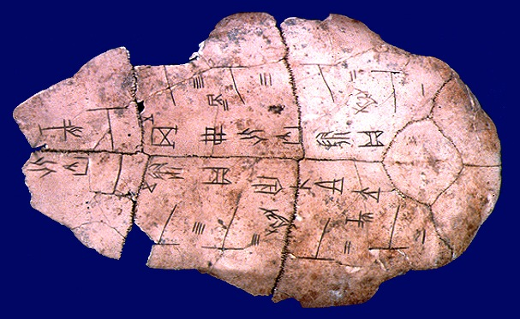
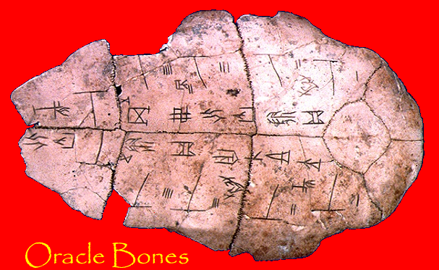
Shang Dynasty (1532-1027 BCE)
Develop writing and civilization

Slide 10
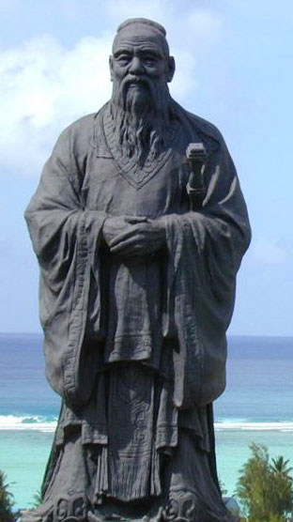
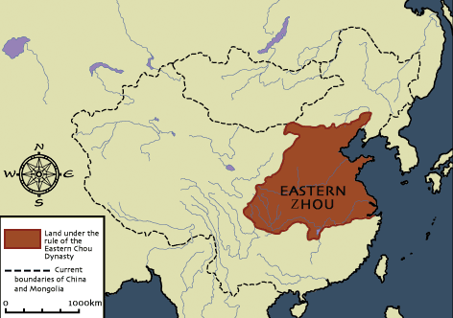
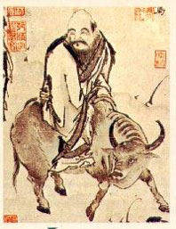
Zhou Dynasty
(1027 BCE-256 BCE)
develops
Confucianism,
Legalism & Taoism

Slide 11
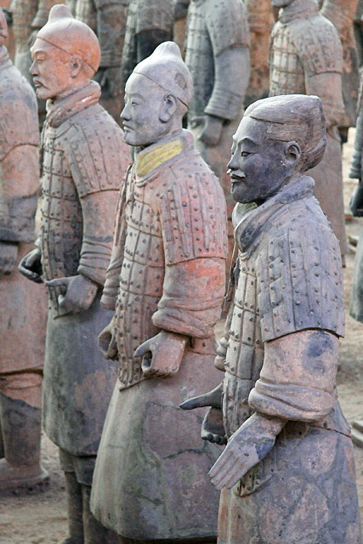
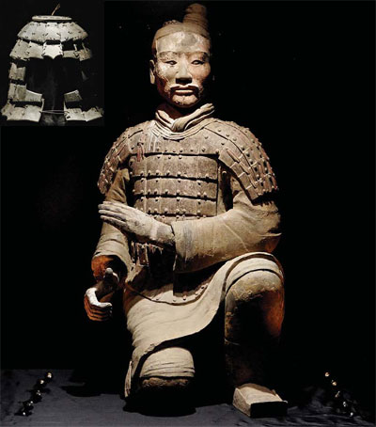
Qin Dynasty (241 BCE – 202 BCE):
Unifies China for the first time
under a centralized (Unitary) government.

Slide 12
What is the difference between a:
FEDERAL GOVERNMENT
UNITARY GOVERNMENT
2 LEVELS of Government (National Government + State Governments)
POLITICAL POWERS SHARED by 2 levels of government
The Constitution is RIGID & CODIFIED
2 DIFFERENT types of LAW
(National + state laws)
ONLY 1 LEVEL of Government (Central Government/National Government)
Political Power held by Central Government only
The Constitution is FLEXIBLE AND UNCODIFIED
ONLY 1 set of law (uniform) for whole country

Slide 13
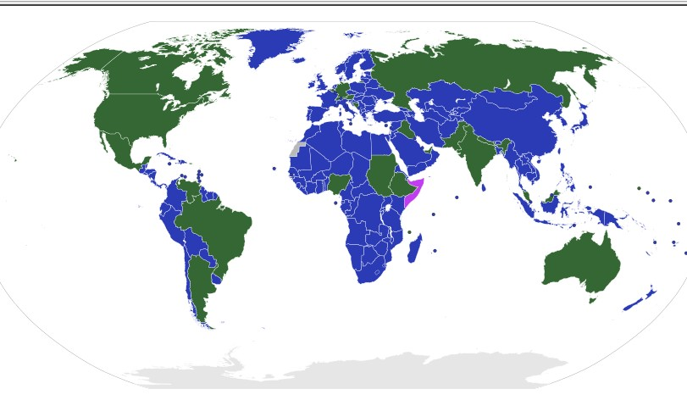
Federal (green) and Unitary (blue) Governments around the World

Slide 14
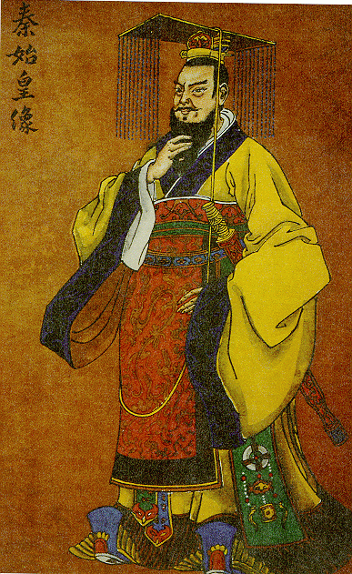
Shi Huangdi (259 BCE- 210 BCE)
China’s
First
Emperor

Slide 15
Policies of Shi Huangdi
“Strengthen the trunk and cut the branches.”
Murdered all rivals.
Enslaved the peasants to build the Great Wall.
Murdered Confucian scholars and burned their books.
Standardized weights and measures, language, and coinage.
Built the terra cotta army.

Slide 16
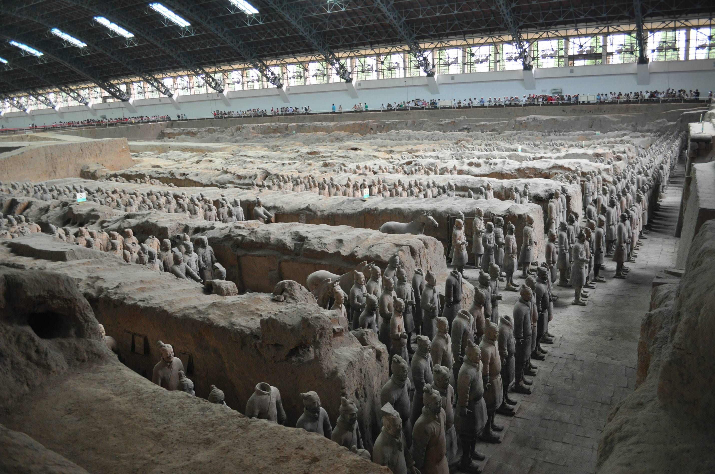

Slide 17
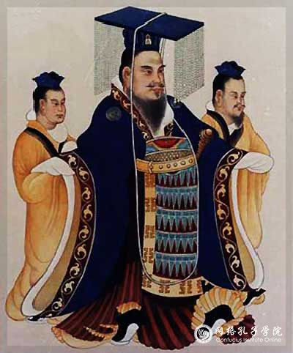
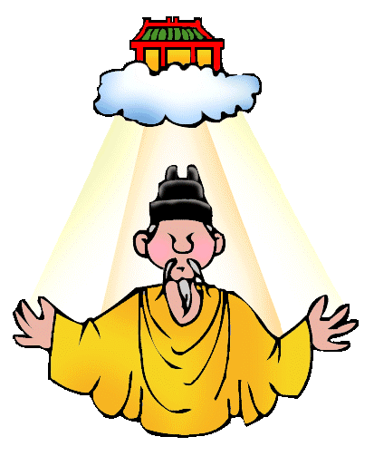
The Emperor and the Mandate of Heaven

Slide 18
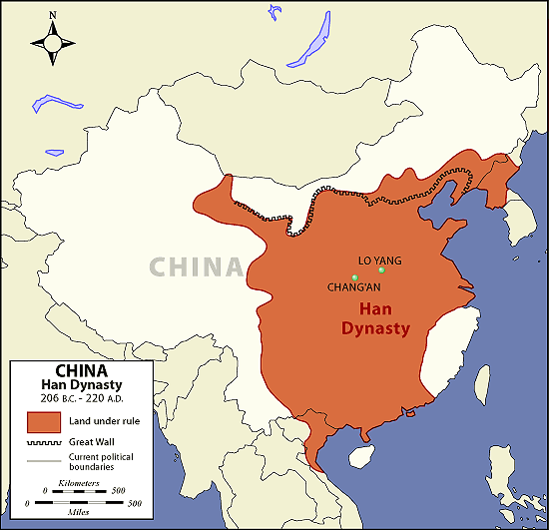
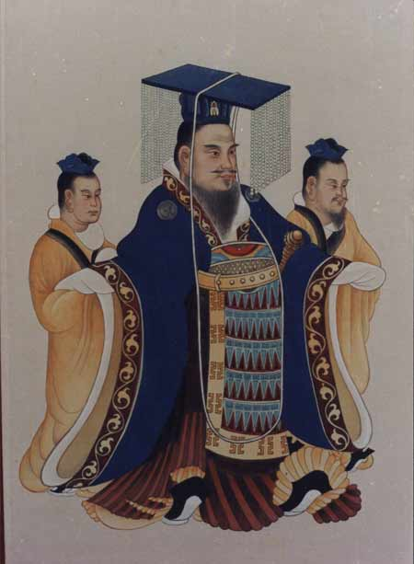
Han Dynasty (202 BCE-220 AD)
Continues centralized government and expands China through war.

Slide 19
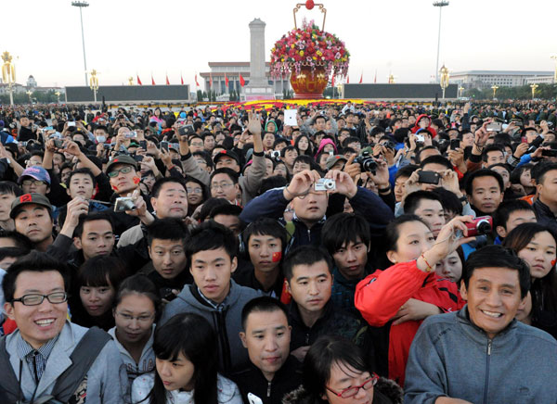
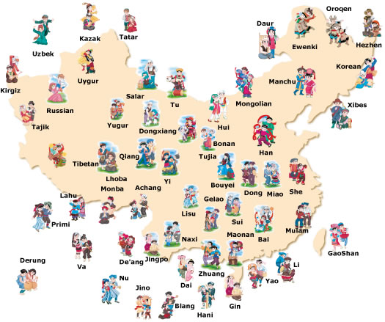
Assimilation and the people of the Han
Modern Chinese people are called Han Chinese.
Han government sent Han Chinese farmers to settle in
newly conquered areas and to intermarry with local people.

Slide 20
So what and who cares?
Today, Han Chinese constitute approximately 92% of the population of Mainland China, 94% of the population of Hong Kong, 95% of the population of Macau, 98% of the population of Taiwan, 74% of the population of Singapore, 25% of the population of Malaysia, and about 19% of the entire global human population, making them the largest ethnic group in the world. There are 1.4 billion Han Chinese including 4 million in the United States.

Slide 21
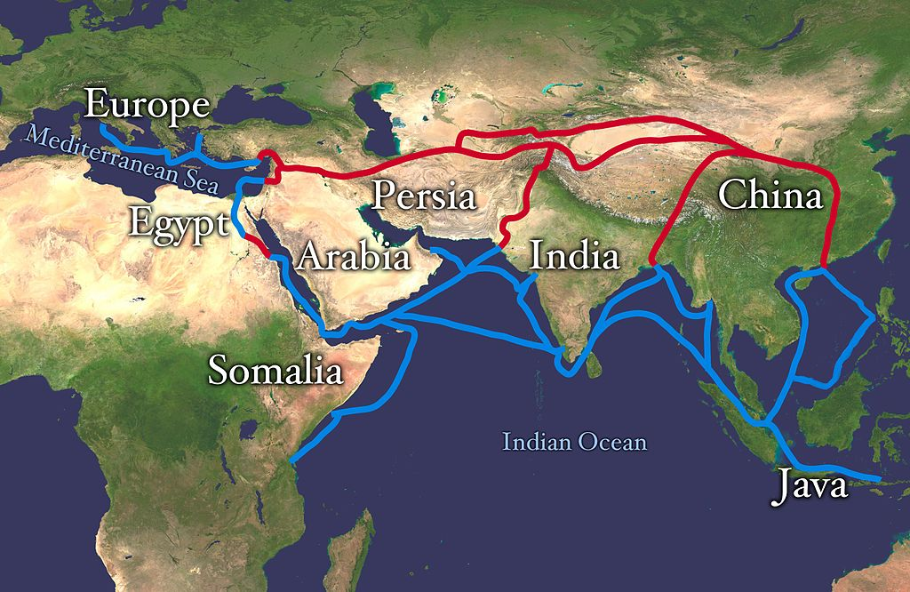
The Silk Road
The Silk Road was a long distance trade route that connected the Han Dynasty and the Roman Empire.
ADD as much of the Silk Road to your map as you can.

Slide 22
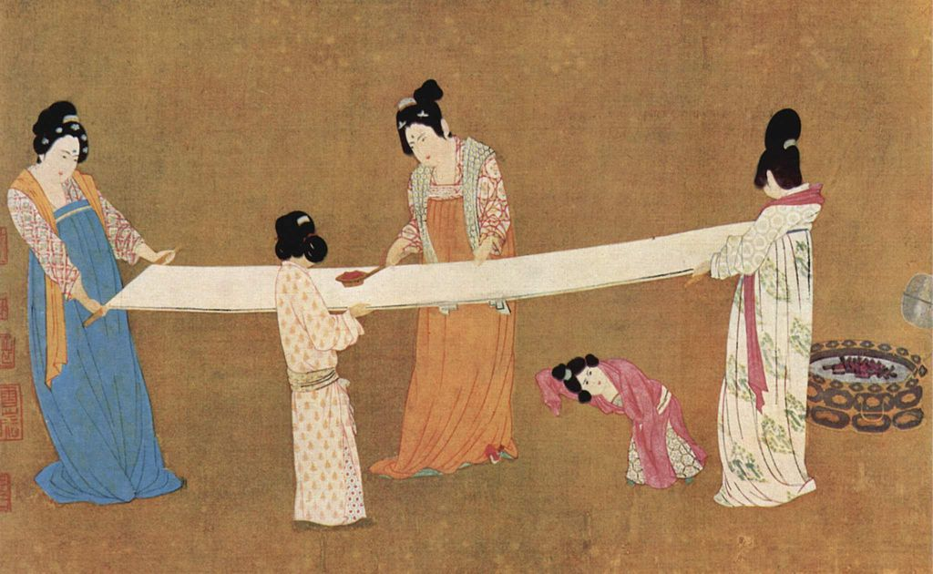
Han Chinese silk clothing became very valuable in ancient Rome
Only the Chinese knew how to make silk and they closely guarded this secret.

Slide 23
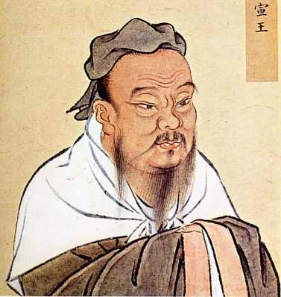
Han Dynasty (202 BCE – 220 AD)
Han emperors employed Confucian scholars to help them govern. Confucianism becomes the official philosophy of the government beaurcracy.

Slide 24
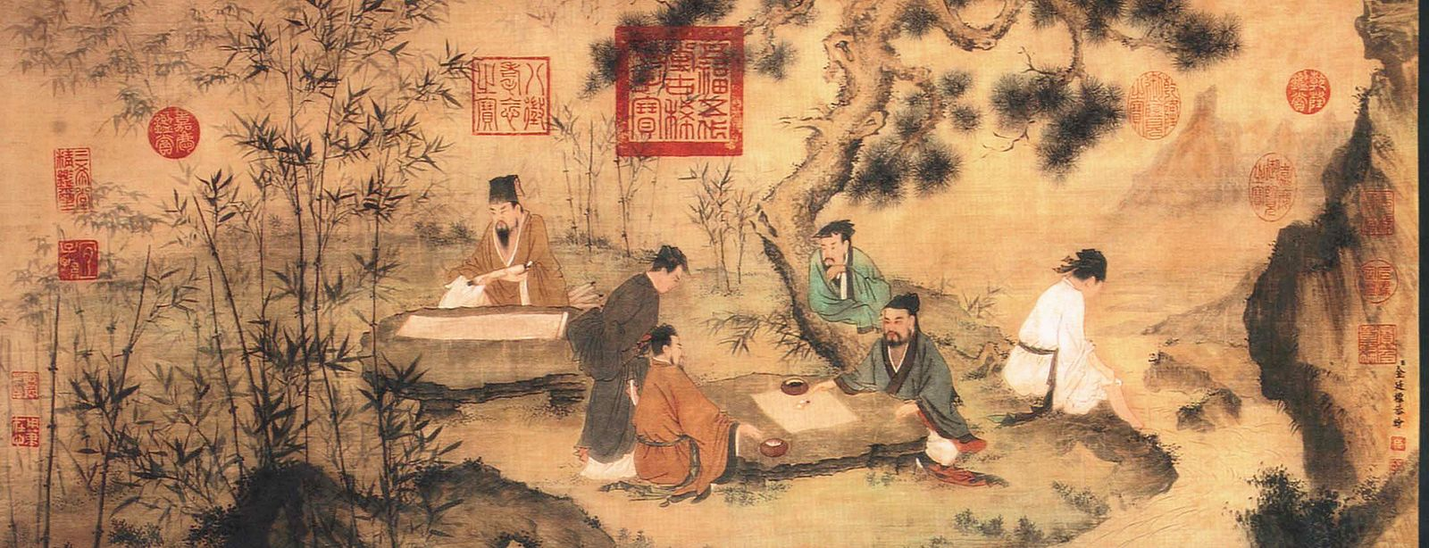
Han Dynasty (202 BCE – 220 AD)
Chinese Civil Service System: begun by Han and lasts until 1912, to get a government job, candidates must pass a test on Confucianism-→ meritocracy

Slide 25
Ts’ai Lun (50 CE – 121 CE)
Inventor of paper
What did people use before paper was invented?
- China: wood, bamboo, silk
- Mesopotamia: stone
- Greece & Rome: papyrus, animal skins
- all were cumbersome, scarce or expensive
After the invention of paper, China begins to rapidly advance. Remains a state secret for a thousand years.

Slide 26
Activity
Each group gets a placard. Treat these things nicely.
Match the placards with written information on the wall.
Record notes on the written information A-O. There are 15 achievements.

