Slide 1
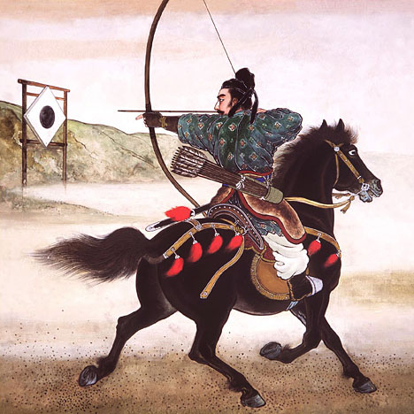
From Samurai to Sony: Three Periods of Asian History

Slide 2
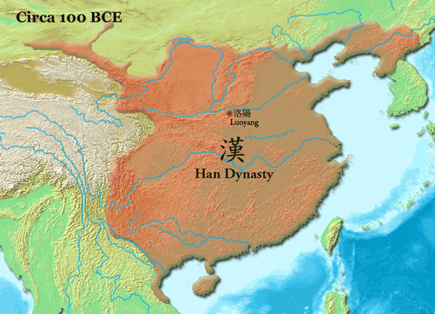
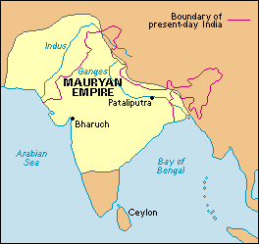
Period 1: Ancient Kingdoms and Empires (ancient times to 1747)
Kingdoms and Empires establish political boundaries, promote religion, and establish national identities.
Examples: Han in China, Mauryan in India

Slide 3
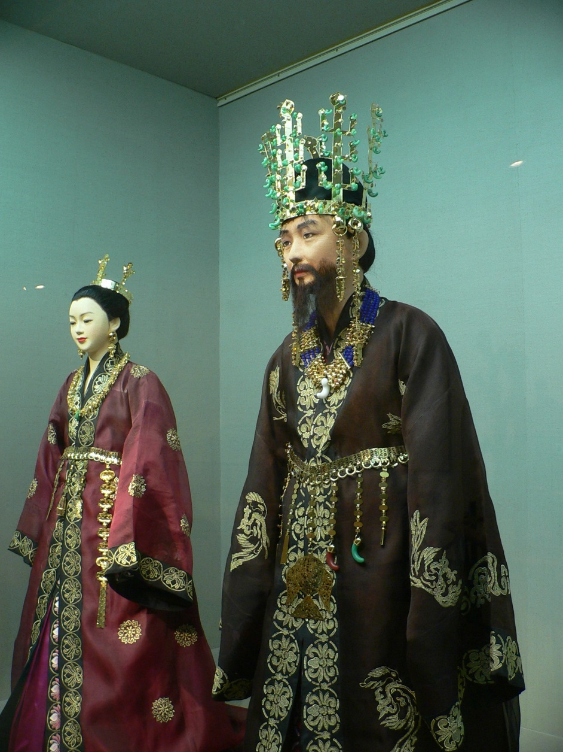
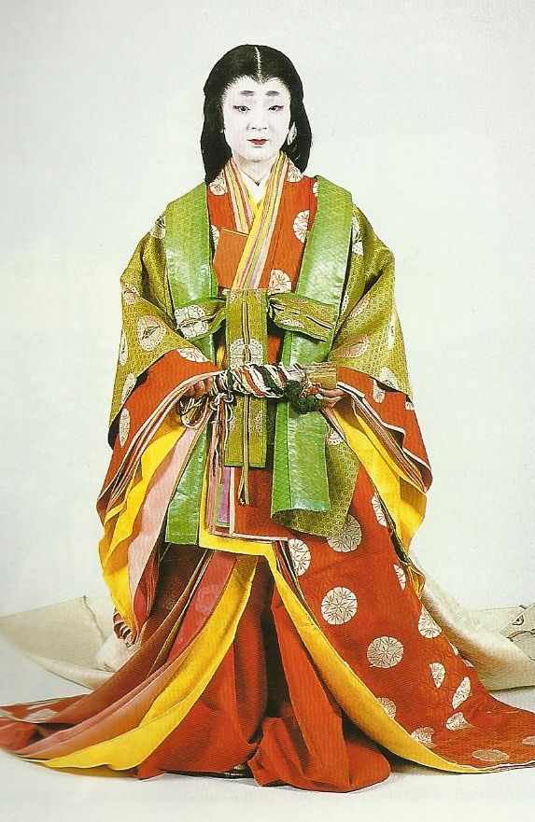
Silla Dynasty in Korea
Heian in Japan

Slide 4
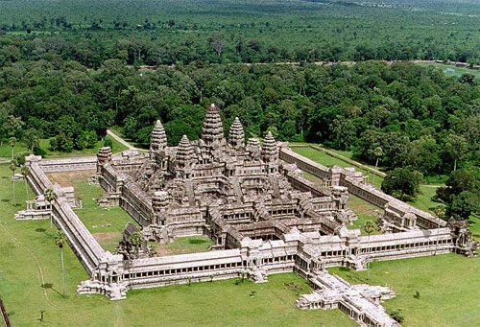
Khmer Empire in Cambodia

Slide 5
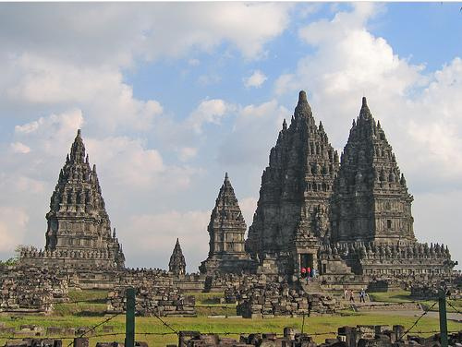
Srivijaya Empire in Indonesia

Slide 6
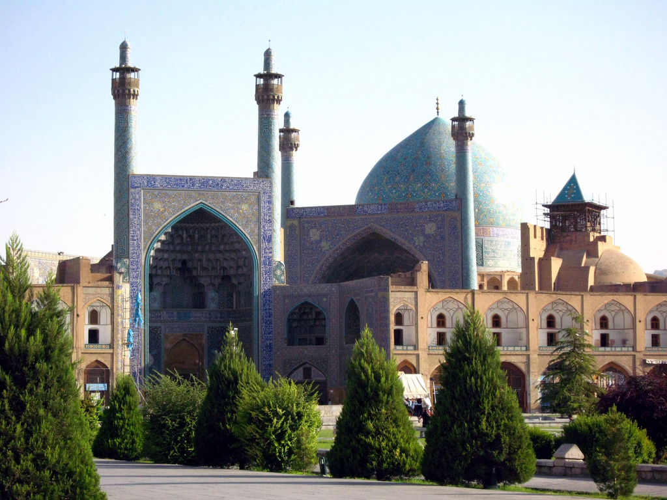
Mongols and Muslims dominated Central and West Asia

Slide 7
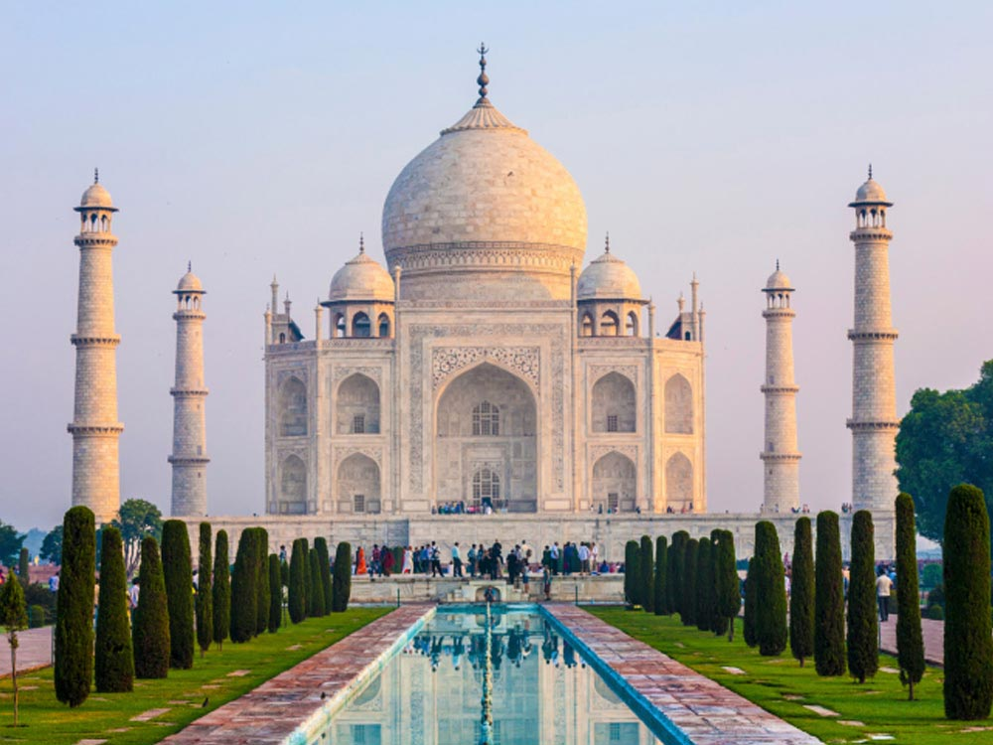
And the Mughals brought Islam to India

Slide 8
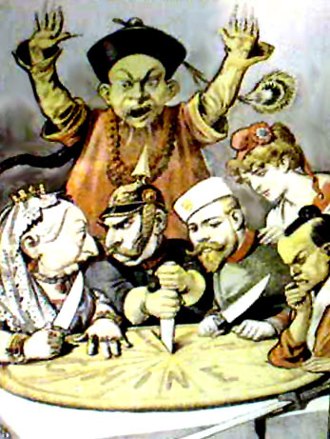
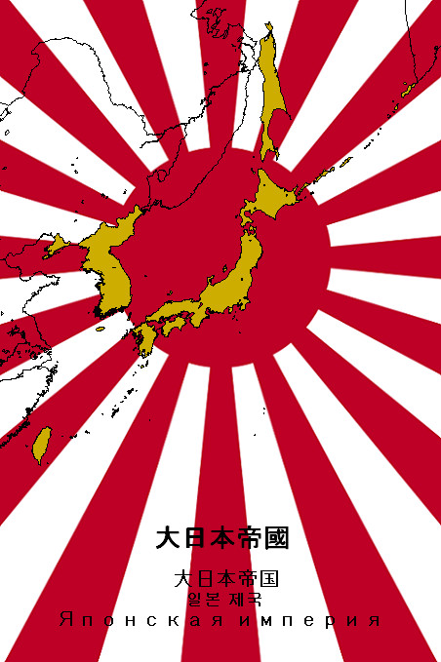
Period 2: European Dominance and War (1757-1945)

Slide 9
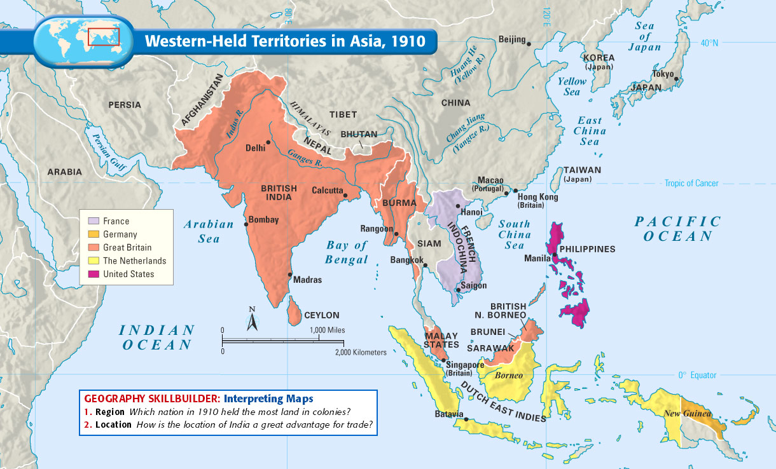
Western Powers colonize and oppress South and Southeast Asia

Slide 10
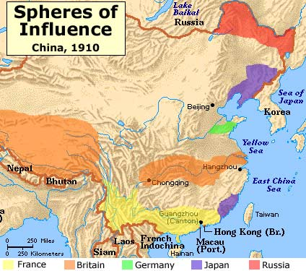
Foreign Powers take over Chinese trade

Slide 11
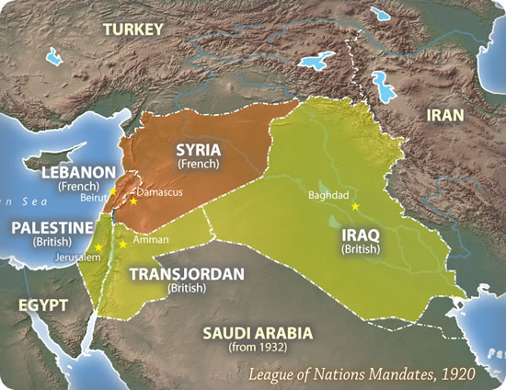
Arabs are denied independence in post World War I settlements

Slide 12
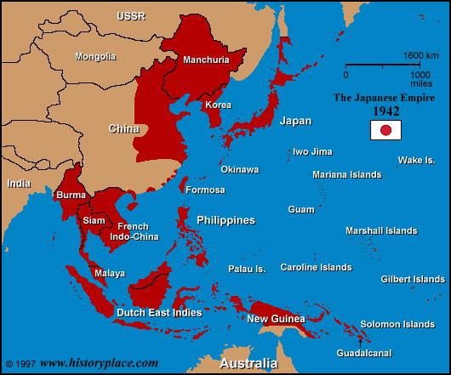
Empire of Japan makes war on East and Southeast Asia

Slide 13
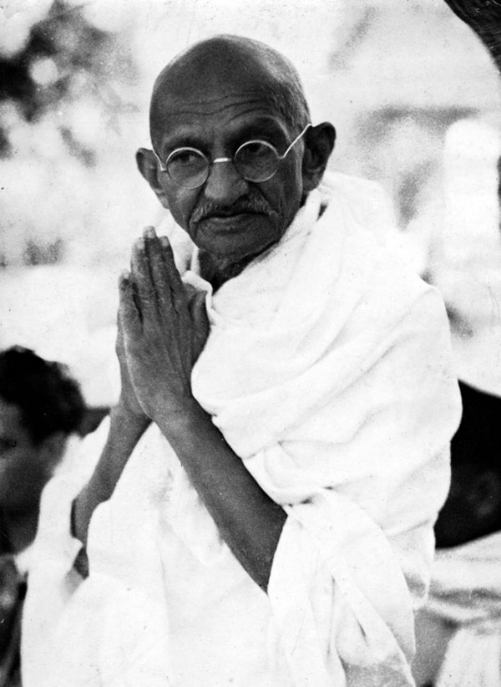
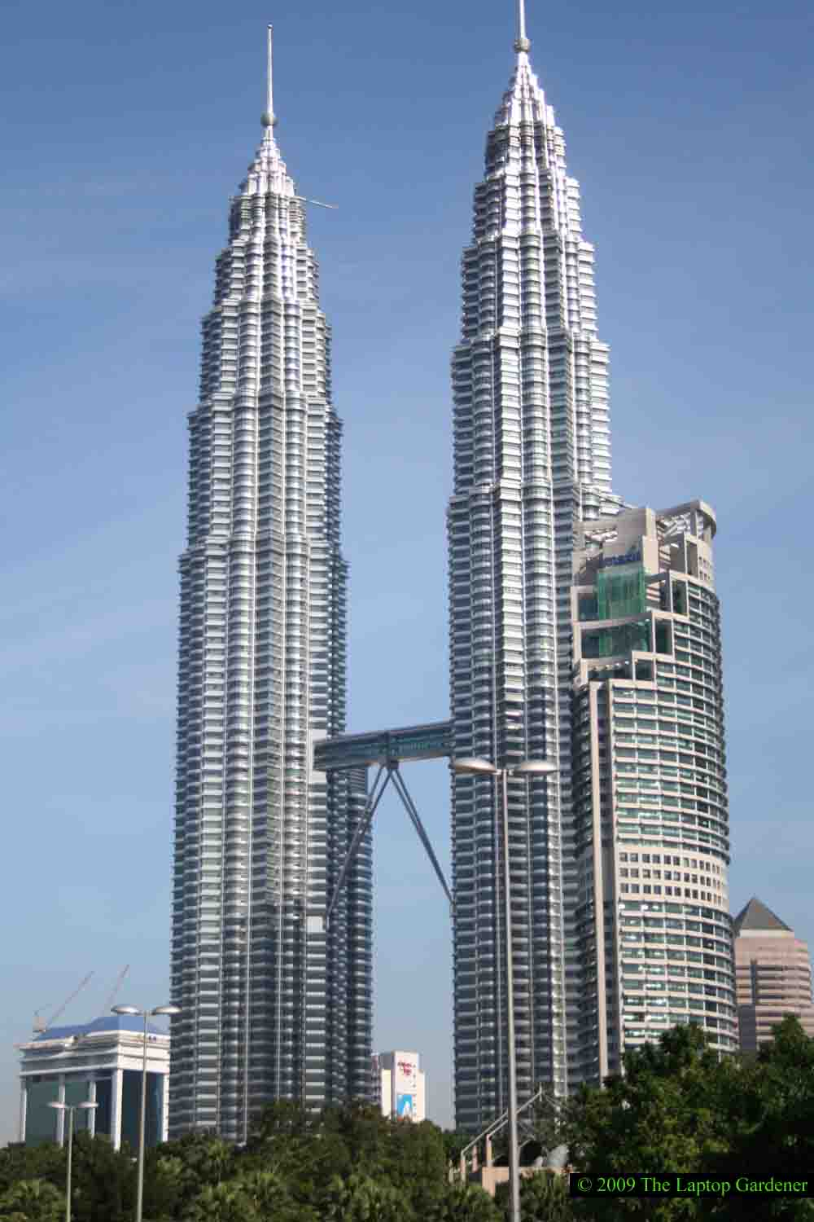
Period 3: Independence and Growth (1947-present)

Slide 14
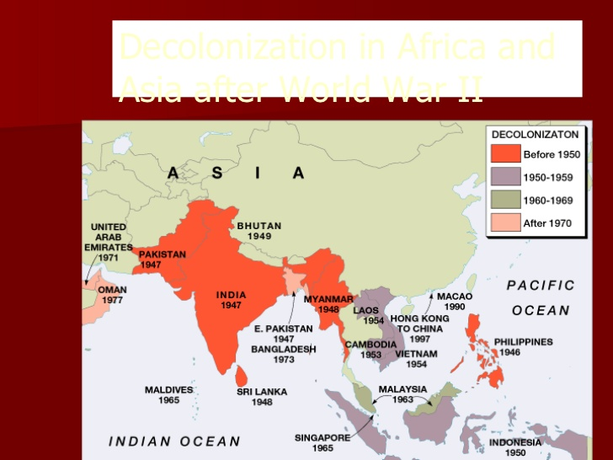
Asians colonies win Independence after World War II

Slide 15
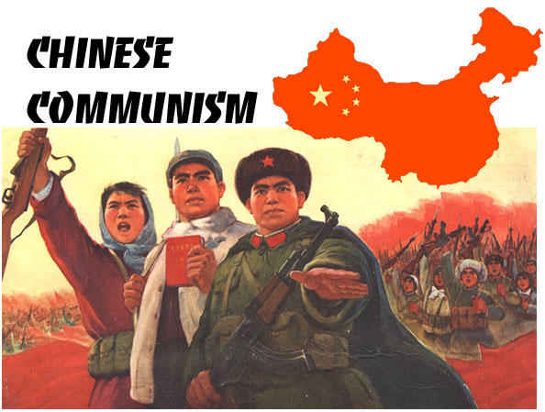
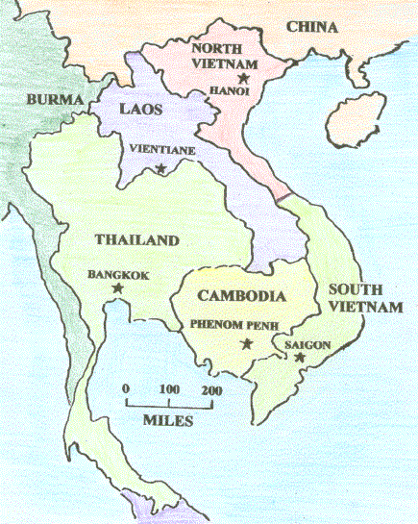
Independence brings war and dictatorship
Communists establish a harsh dictatorship in China
Millions killed as Vietnam, Cambodia and Laos fight to establish Communism

Slide 16
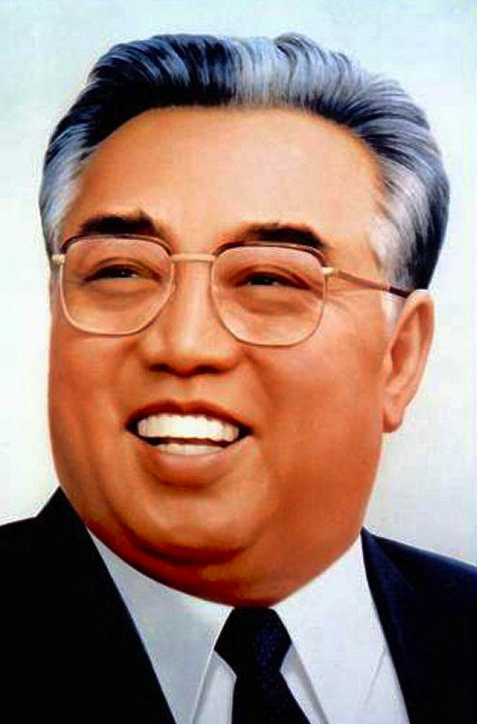
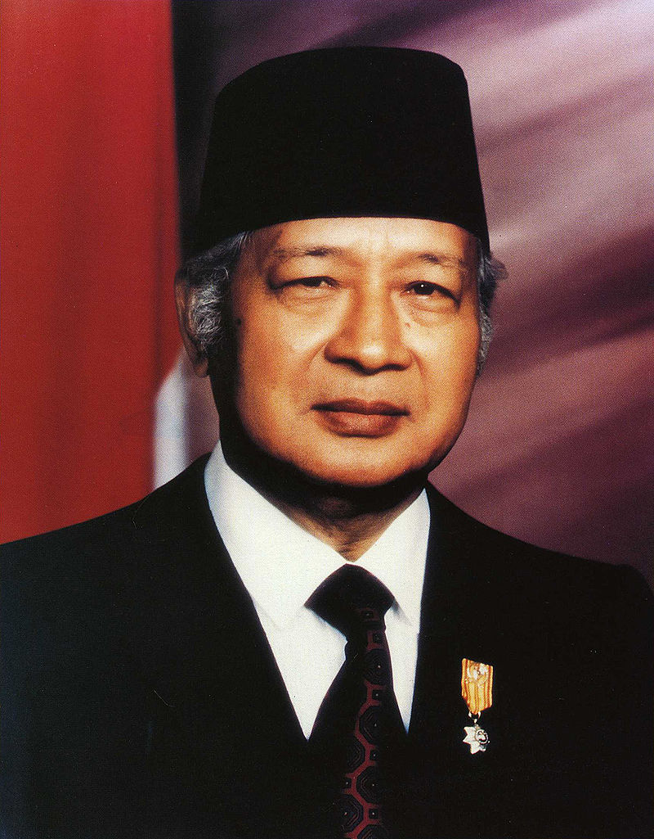
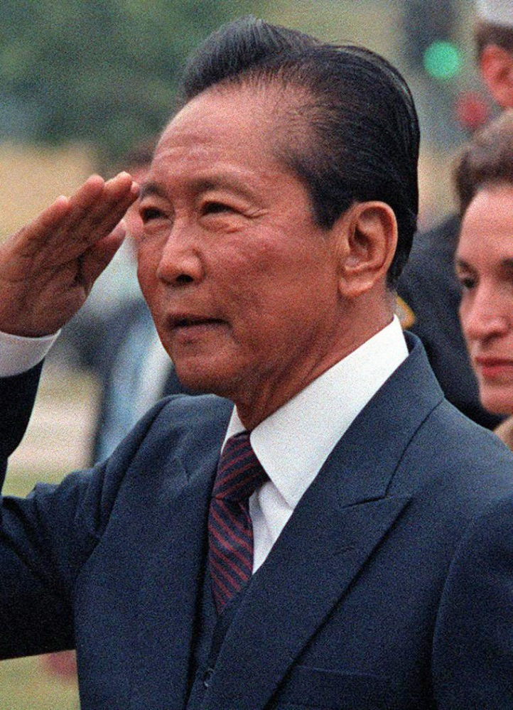
Harsh dictators suppress human rights and murder millions in North Korea, Indonesia and the Philippines
Kim Il Sung
Suharto
Ferdinand Marcos

Slide 17
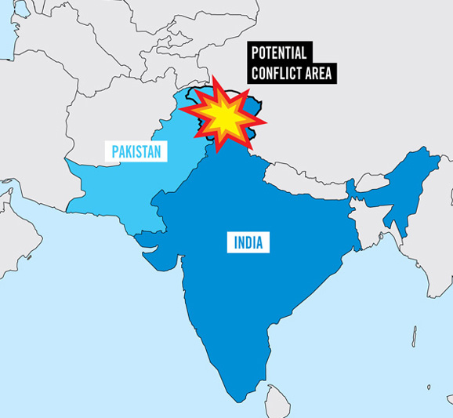
Partition of India leads to wars between Pakistan and India

Slide 18
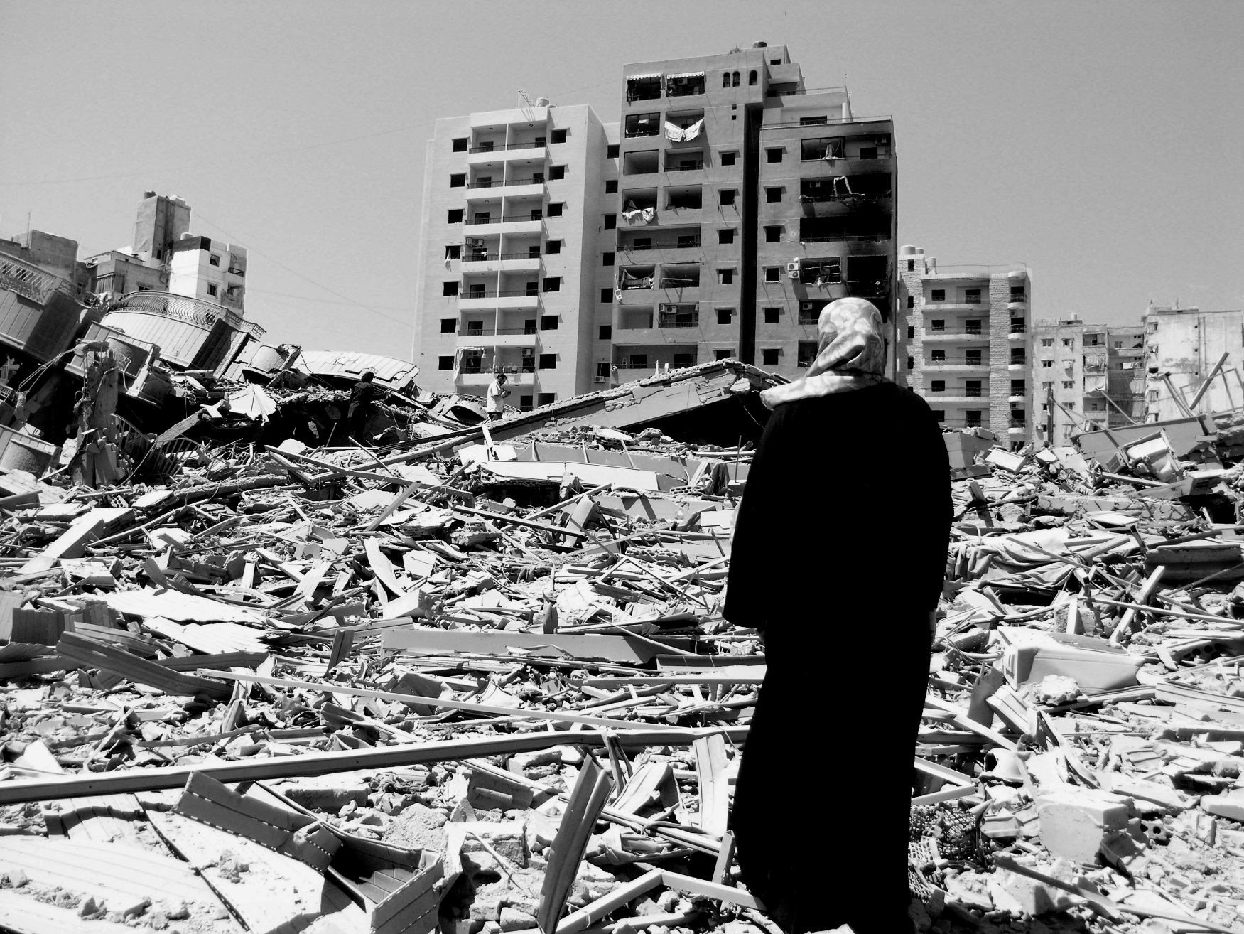
Arabs grow rich on oil and follow disastrous anti-Western, anti-Israel policy

Slide 19
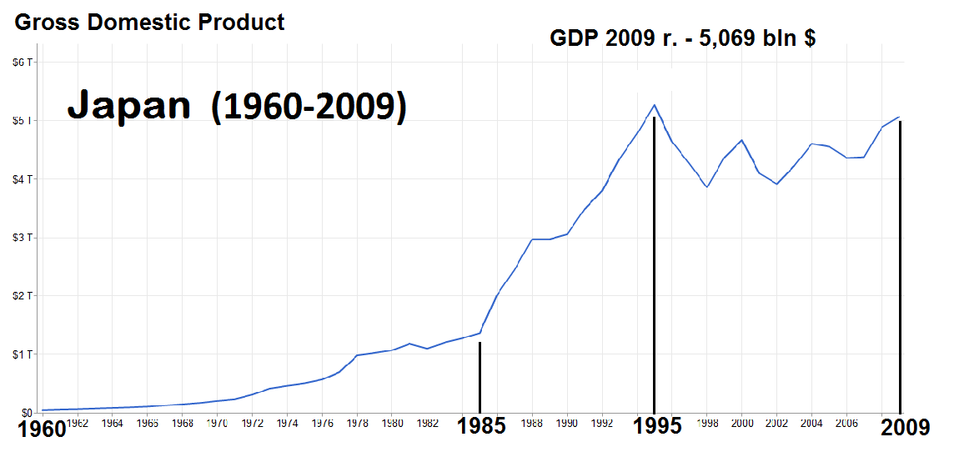
In the 1980’s and 1990’s, Asia begins to stabilize and economies grow.
Japan became the second richest country in the world in the 1980’s.

Slide 20
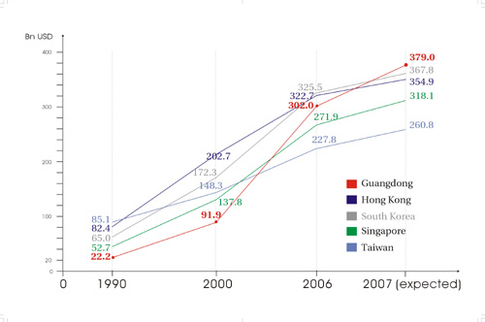
The “Four Asian Tigers”- Hong Kong, South Korea, Taiwan and Singapore- follow Japan’s lead

Slide 21
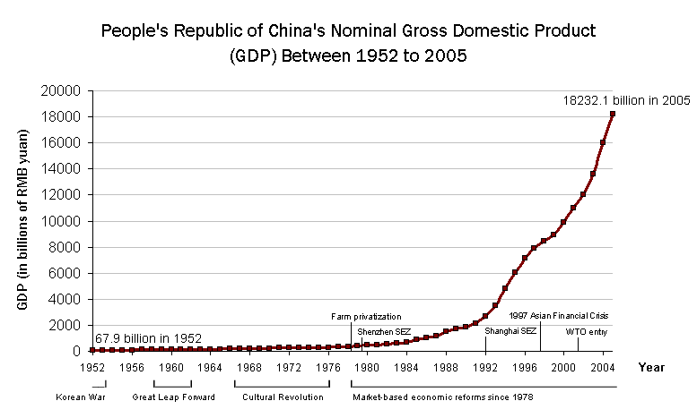
From 1978 to 2013, the Chinese economy grew at 10% a year becoming the second biggest economy in 2010

Slide 22
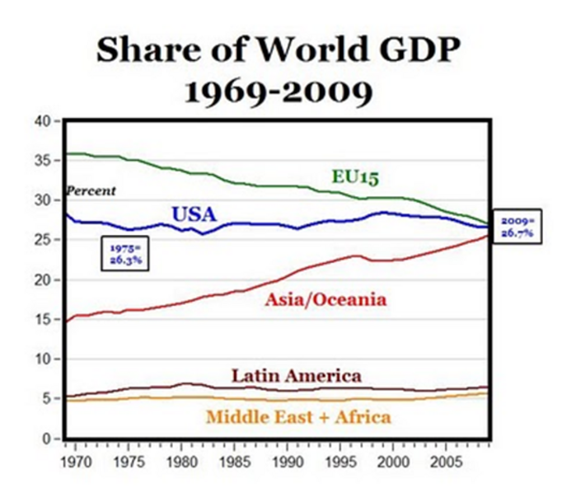
Asian countries are poised to be the economic leaders of the world

Slide 23
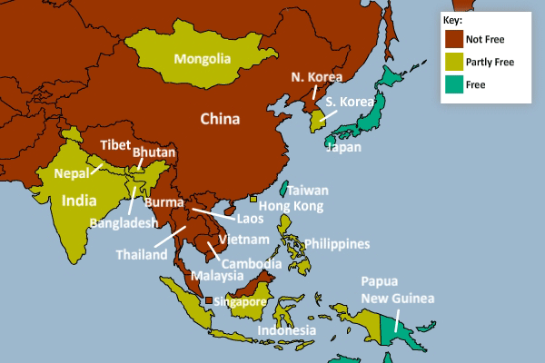
Despite the economic growth, freedoms are limited in most of Asia

Slide 24
How did you describe the different periods?
Period 1: Ancient Kingdoms and Empires (ancient times to 1757)
Period 2: European Dominance and War (1757-1945)
Period 3: Independence and Growth (1947-present)

Slide 25
Project Rubric
Read project rubric together
Remember = September 28th and November 1st
September 28th = Mark, Alana, Kaidyn, Faithly, Yajhaira, Elfego, Zachary, Samuel
November 1st = Janie, Giselle, Victoria, Lydia, Blake, Lukas, Matthew, Evan, Calvin, Kannon, Ethan, Eli, Shiloh, Katey

