Slide 1
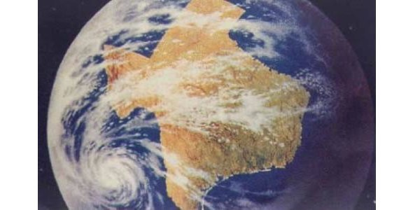
What is bigger than Texas?
268,000 square miles
790 miles long
26 million people

Slide 2
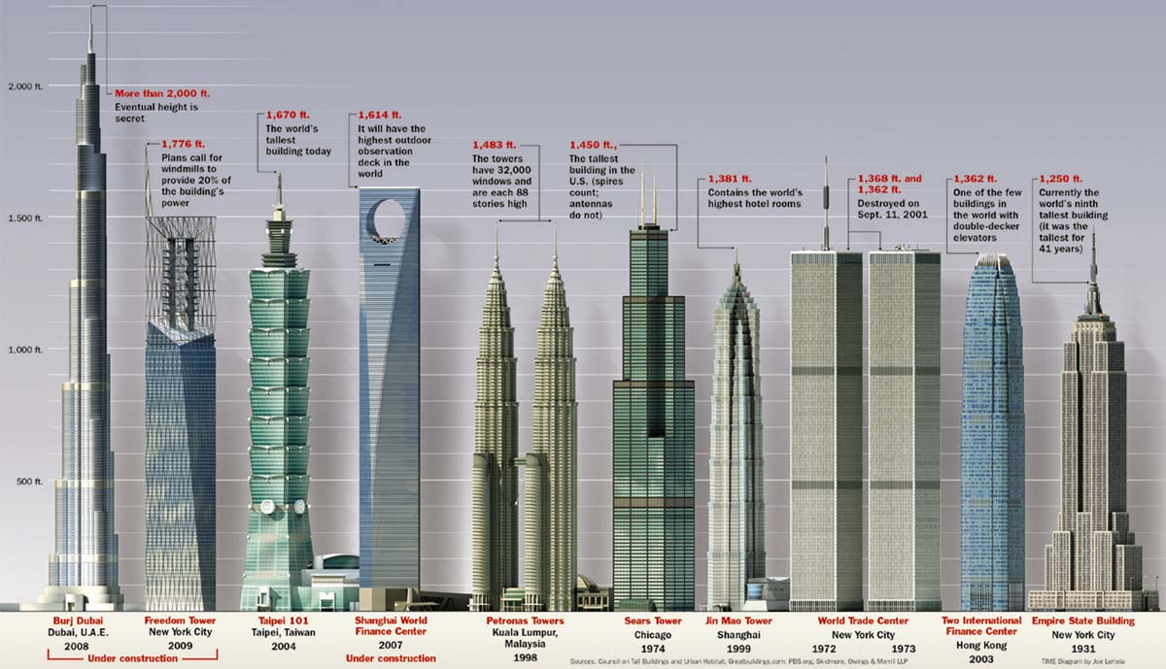
Geography Scavenger Hunt of Asia: Biggest, Tallest, Deepest, etc.

Slide 3
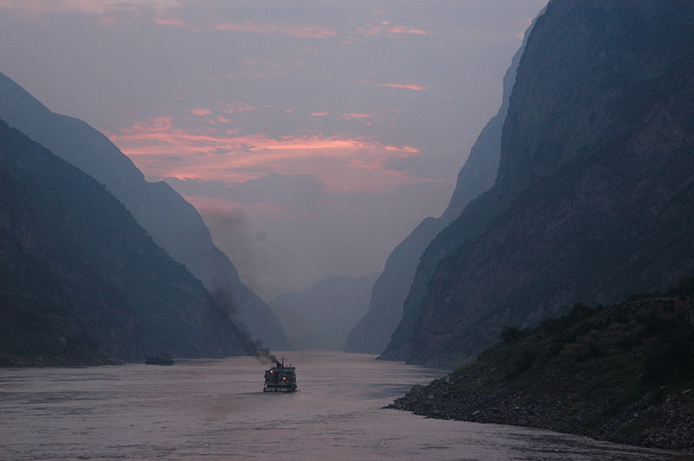
Yangtze River, China
Longest river in Asia and third longest in the world at 3,917 miles
Amazon and Nile are longer by 60 and 200 miles
Yangtze flows from the mountains of Tibet and empties in the South China Sea at Shanghai
The Three Gorges Dam on the Yangtze is the world’s largest hydroelectric dam in the world
The Yellow River in China is the 2nd longest river in Asia and the 6th longest in the world

Slide 4
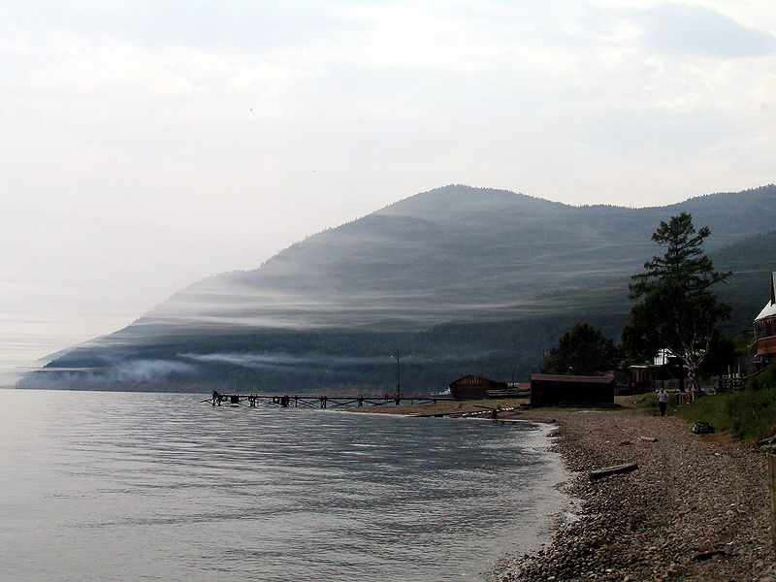
Lake Baikal, Russia
Largest, deepest and oldest lake in the world
Average depth is 2,225 feet
Lake Travis is one of the deepest lakes in Texas at 210 feet
Contains 20% of the world’s unfrozen freshwater

Slide 5
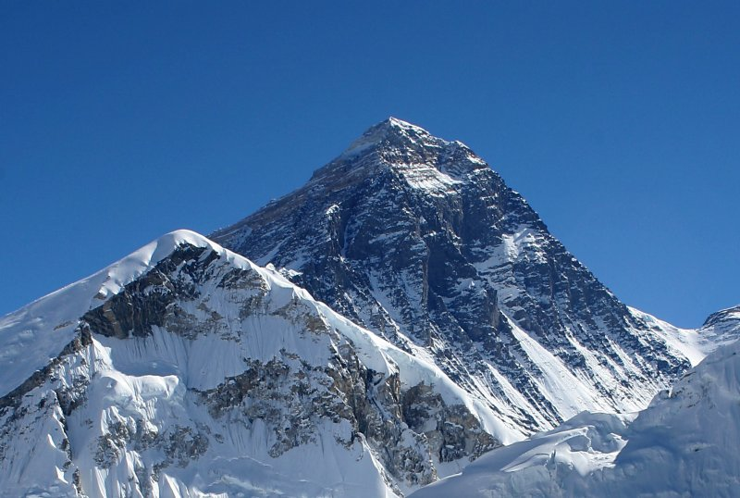
Mt. Everest, border of Nepal and China
World’s tallest mountain at 29, 029 feet
Four times taller than the highest mountain in Texas
Part of the Himalayan mountain chain, the tallest mountain chain the world
The Himalayas contain over 100 peaks over 23,000 feet (the highest peak outside of Asia, Mt. Aconcagua in the Andes is 22,841)

Slide 6
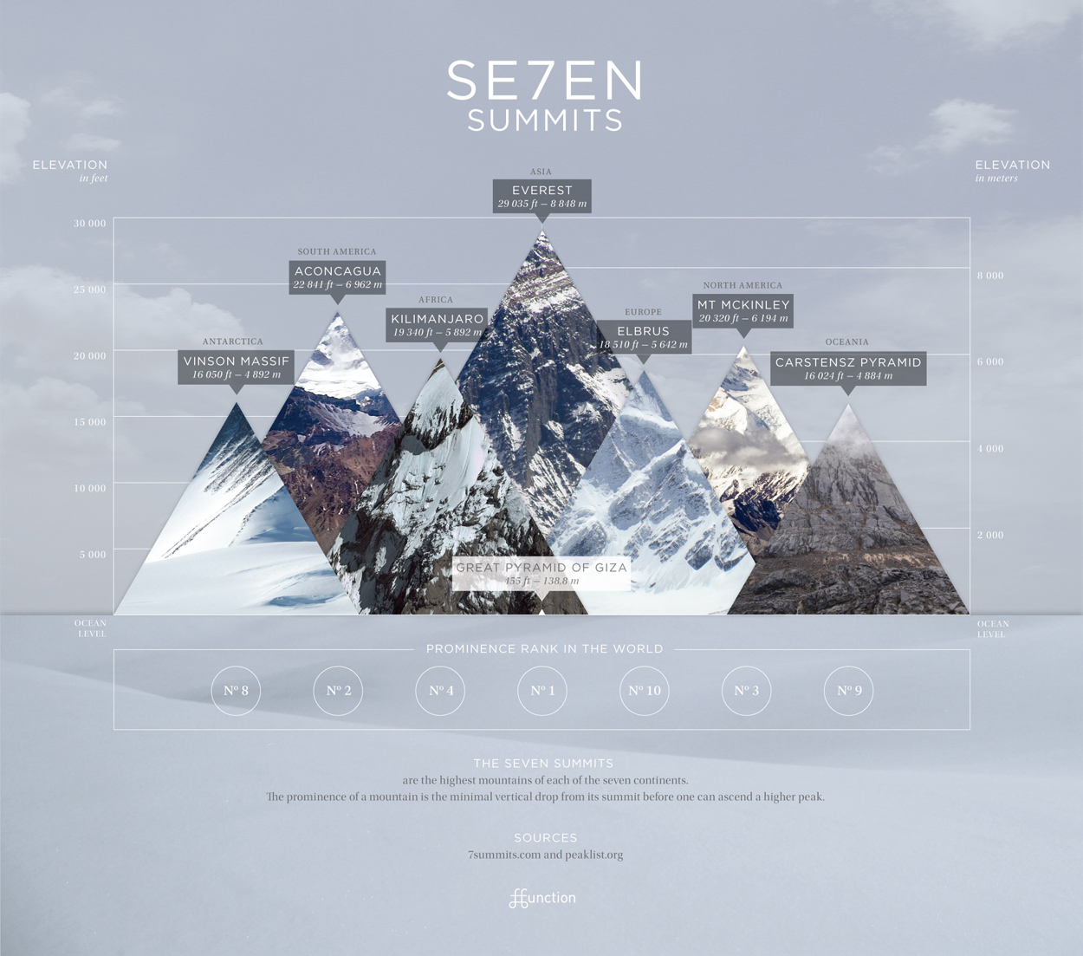

Slide 7
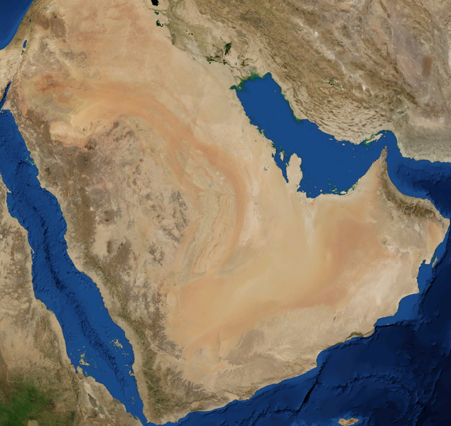
Arabian Desert
The second largest non-polar desert in the world at 900,000 square miles
(4 times the size of Texas)
Includes 8 different countries
Major source of oil and famous in history for the birth of Islam
One of the highest temperatures ever recorded on earth was in the Arabian desert at 126 degrees

Slide 8
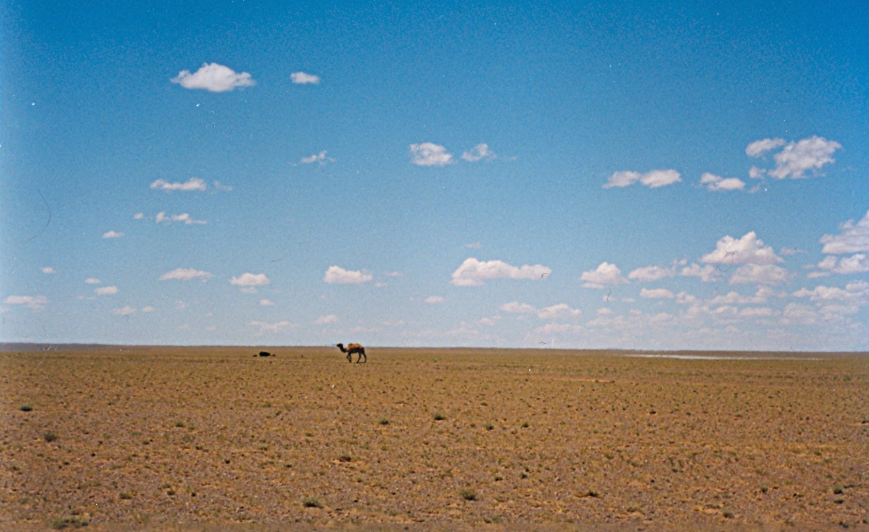
Gobi Desert
2nd largest desert in Asia and the 3rd largest in the world at 500,000 square miles (twice the size of Texas)
Located in southern Mongolia and northwestern China
Famous in history for the Mongol Empire and Silk Roads
The Gobi is a cold desert with temperatures ranging from minus 40 degrees to 118 degrees
The temperature in the Gobi can change by 95 degrees in a 24 hour time period

Slide 9
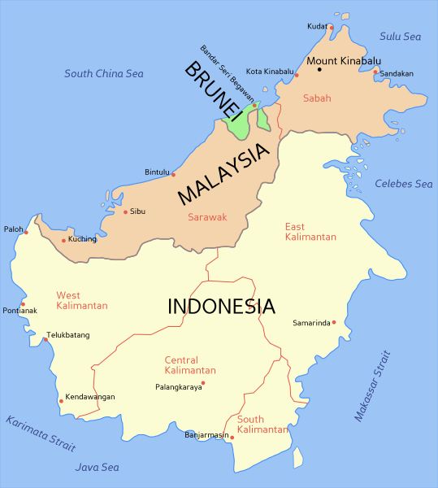
Borneo
World’s third largest non-continent island at over 288,000 square miles (slightly larger than Texas)
18 million people live on the island
The nearby Indonesian island of Sumatra is the 6th largest island in the world

Slide 10
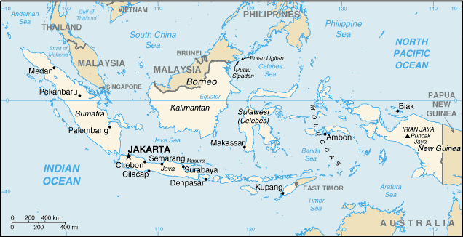
The Indonesian Archipelago consists of 18,306 island with 922 permanently inhabited and 8,844 have names
Indonesia has three times as much land as Texas stretched over a length longer than the United States

Slide 11
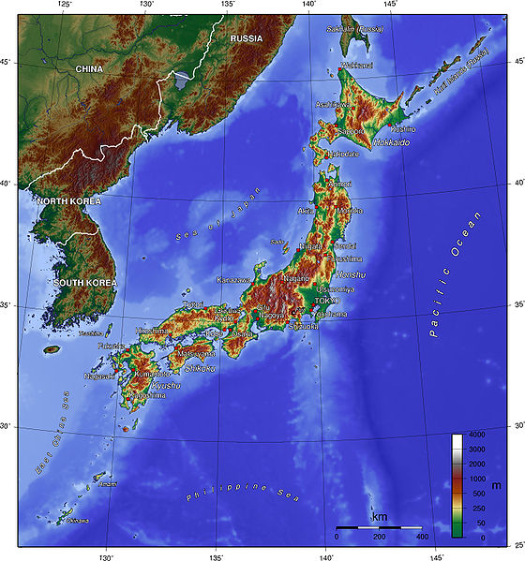
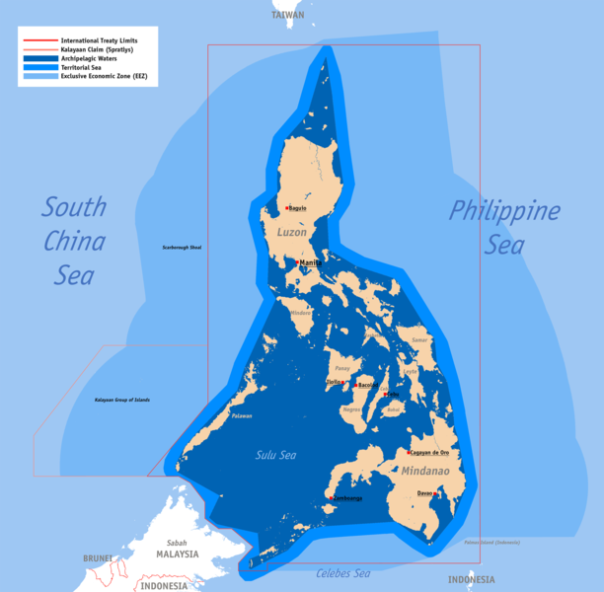
Japan is made up of
6,852 islands
The Philippines is made up of
7,107 island

Slide 12
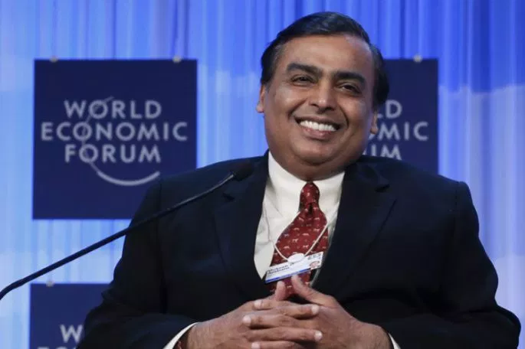
Richest Person in Asia
Mukesh Ambani is worth $42.3 billion
He owns the majority shares in petrochemical/oil/gas company called Reliance Industries Limited
He lives in India
The richest person in Texas is Alice Walton (18 billion) followed by Michael Dell (16 billion)

Slide 13
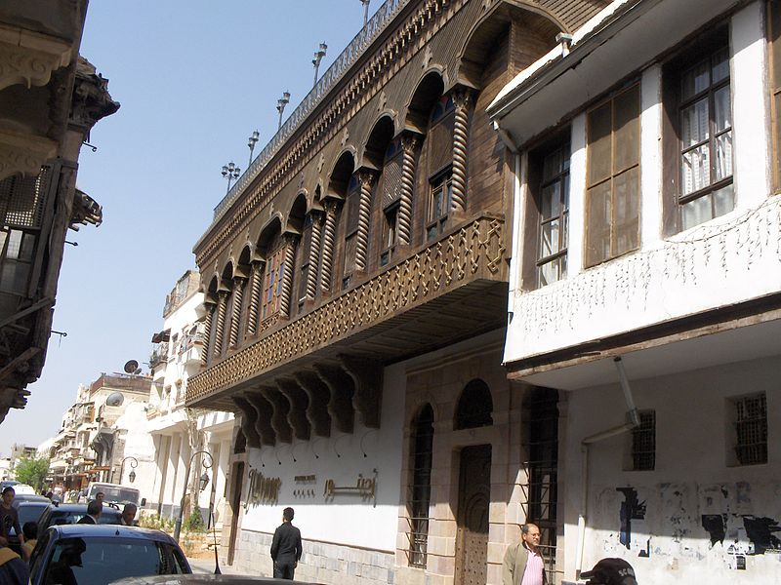
Damascus, Syria is considered to be the world’s oldest continuously inhabited city and the oldest in Asia. Dating to 9000 B.C., it is 63 times older than Texas.

Slide 14
City with the Longest Name in Asia and the longest place name in the world?
Krung Thep Mahanakhon Amon Rattanakosin Mahinthara Ayuthaya Mahadilok Phop Noppharat Ratchathani Burirom Udomratchaniwet Mahasathan Amon Piman Awatan Sathit Sakkathattiya Witsanukam Prasit
Or: The city of angels, the great city, the residence of the Emerald Buddha, the impregnable city (of Ayutthaya) of God Indra, the grand capital of the world endowed with nine precious gems, the happy city, abounding in an enormous Royal Palace that resembles the heavenly abode where reigns the reincarnated god, a city given by Indra and built by Vishnukarn.
Most people just call it Krung Thep or Bangkok
The long name of Krung Thep has how many more letters than Texas?

Slide 15
What town in Asia is the furthest point from the sea on the globe?
Xianjing – the geographic “center” of Asia
The capital of Xianjing is Urumqi
There is a tourist attraction there to commemorate the location as the farthest trading point away from any sea.

Slide 16
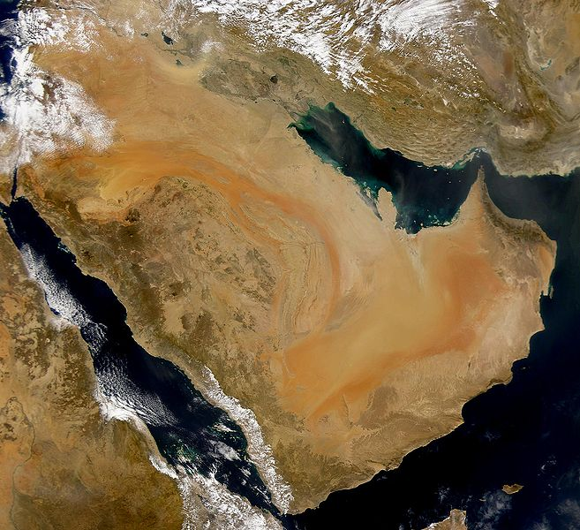
The Arabian Peninsula is the
largest peninsula in the world at 1.25 million square miles

Slide 17
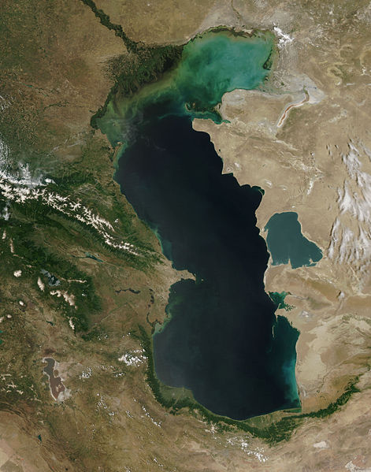
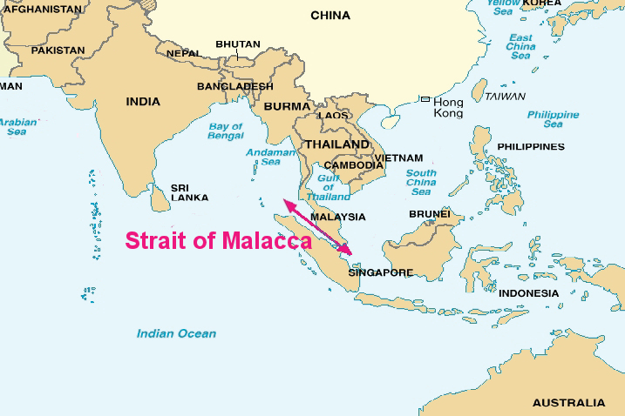
The Caspian Sea is the largest inland body
of water on earth and the largest in Asia.
It is bordered by five countries.
A strait connects two larger bodies of water.
The Strait of Malacca connects the Indian
Ocean with the Pacific Ocean.
The Strait of Malacca is one of the
world’s most important shipping lanes
in the world.

Slide 18
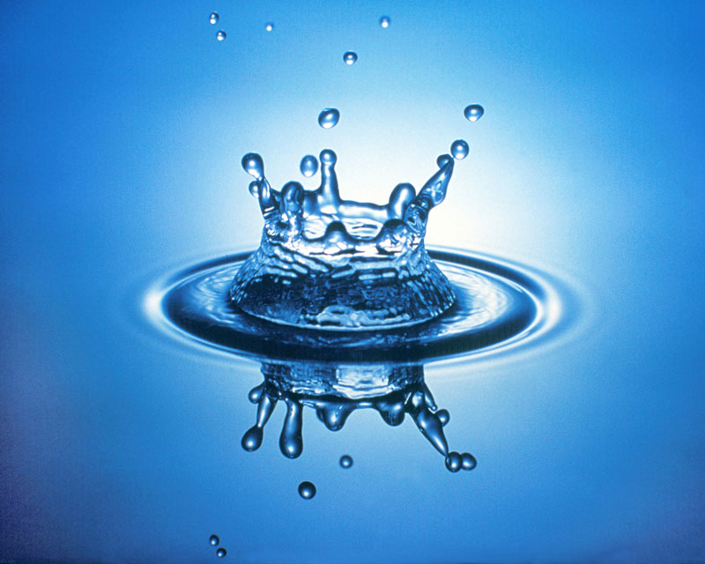
Petroleum, forests, fish, water, rice, copper and silver

Slide 19
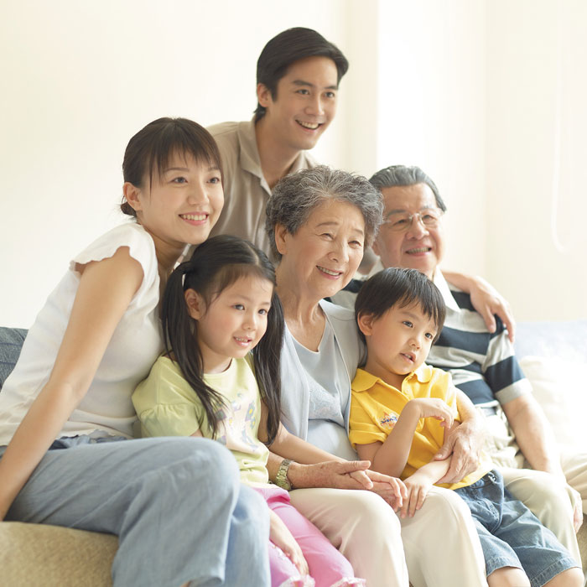
Han Chinese are the largest ethnic group in the world with just over 1.3 billion or 20% of the world’s population
92% of the People’s Republic of China
98% of Taiwan
74% of Singapore
24.5% of Malaysia
3.4 million live in the United States
For every 1 Texan, there are 50 Han Chinese

Slide 20
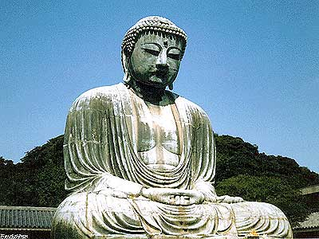
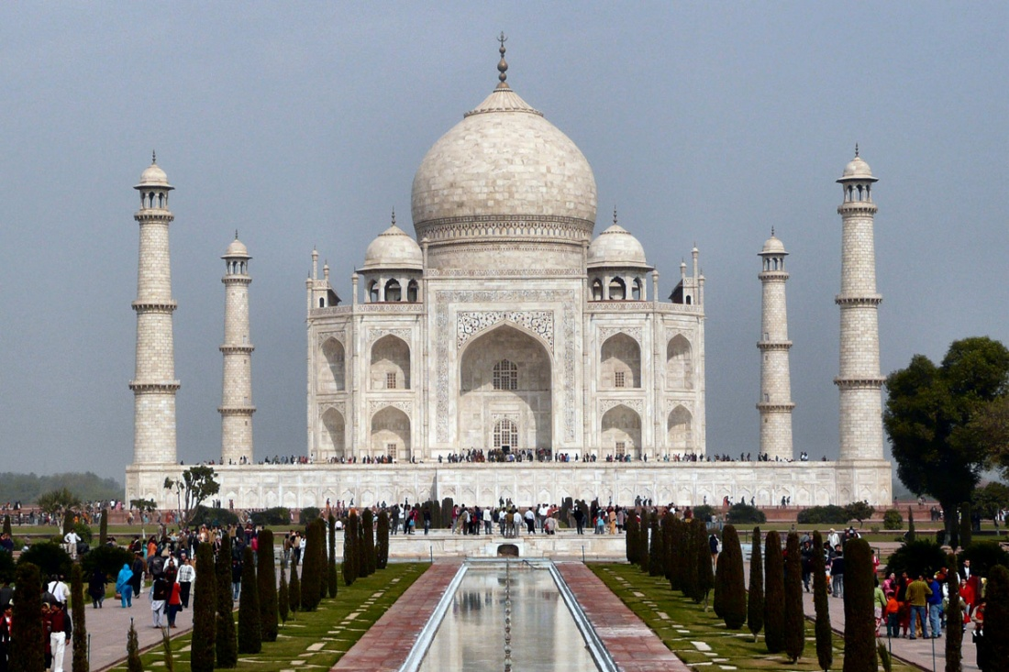
Over 1 billion Asians are Muslim
Indonesia, Pakistan, India and Bangladesh each have over 100 million Muslims
Hinduism is the second largest religion in Asia with just under 1 billion followers
Or, maybe Buddhism is the largest. There are between 230 million to 1.6 billion Buddhists.
Buddhism is practiced alongside other religions and China does not keep official statistics of religion.

Slide 21
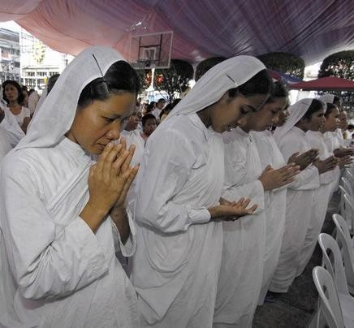
What country has the largest Christian population in Asia
The Philippines with over 90 million Christians (most of them Roman Catholic)
Christianity is the largest single religion in South Korea (although half the population says they have no religion)
There are 11 million Christians in Texas

Slide 22
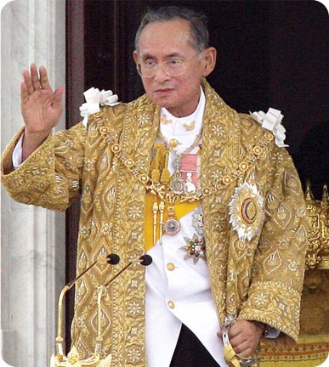
King Rama IX or Bhumibol Adulyadej
King of Thailand since June 9, 1946
Considered head of state in a Constitutional Monarchy- he holds tremendous political power
He is the world’s richest royal worth about $35 billion dollars
Rick Perry is the longest serving governor in Texas history at 12 years with a net worth of $3.3 million

Slide 23
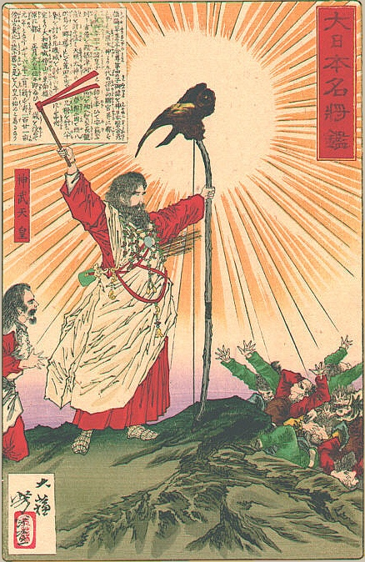
Oldest country in Asia?
Almost impossible to answer.
Japan claims a traditional founding date of 660 BC
China claims a starting date of 221 BC
Texas was founded in 1836 making it nearly 2,000 years younger than China

Slide 24
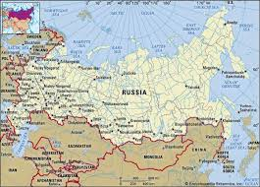
Largest country in Asia?
Russia
17,075,200 square kilometers
Home to 144 million people
Russia has 11 different time zones

Slide 25
Largest city in Asia by square miles/kilometers?
Tokyo, Japan
13,500 square kilometers of land area
Around 2,644 people per square mile
Austin is 271.8 square kilometers

Slide 26
Largest city in Asia by population?
Tokyo, Japan
38.2 million people live in Tokyo

Slide 27
Smallest city in Asia?
Singapore, Indonesia
Singapore is classified as a city-state or micronation
276 square kilometers

Slide 28
Northernmost city in Asia?

