Slide 1
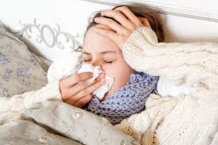
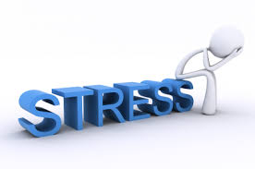
How Do You…?
How do you treat a cold?
How do you treat a headache?
How do you treat a backache?
How do you treat an injury?
How do you treat allergies? (Seasonal and food)
How do you treat stress?
How do you treat ADD?
How do you treat anxiety and/or depression?

Slide 2
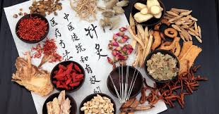
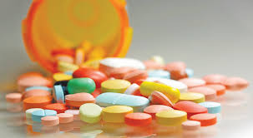
Asian medicine and Asian approaches to health
It is meant to inform and should not be taken as medical advice. I am not a medical doctor nor am I trained in any of these approaches.
Talk with your parents or research on your own if you are interested in any of these concepts.
My goal is to educate you on various ideas of humanity, not to convince you on an approach to health.

Slide 3
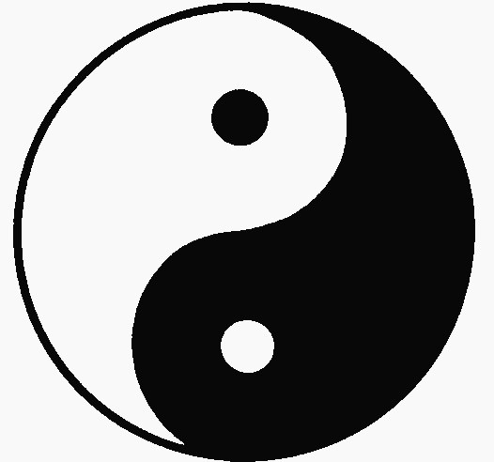
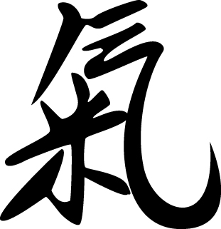
Chinese Philosophy & Human Health

Slide 4
Yin and Yang
Yin = feminine
Yang = masculine
Describes how opposite or contrary forces are actually complementary.
A key part of Chinese philosophy is the importance of harmony and balance.

Slide 5
Qi or Chi
Refers to the “life energy” or “life force” that animates all living beings.
Other cultures have similar concepts but this concept is unidentified by Western science or medicine.
Chi is a central underlying principle of Chinese health and martial arts.

Slide 6
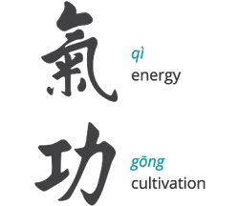
According to Chinese philosophy, Qi must be balanced and cultivated.
Ways to balance and cultivate Qi:
Feng Sui.
Qi Gong (Tai chi)
Martial Arts.
Traditional Chinese Medicine

Slide 7
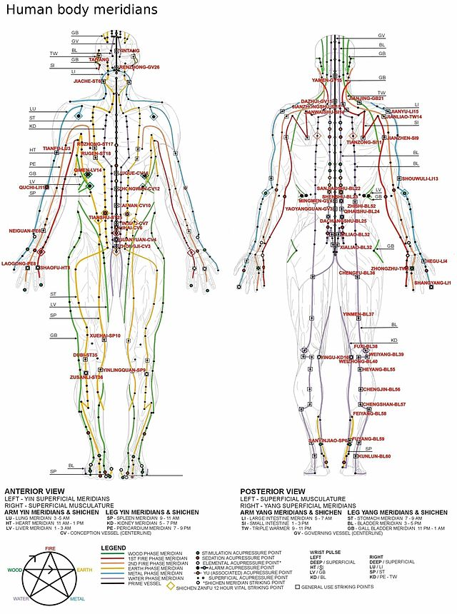
Traditional Chinese Medicine (TCM)
Believes body has natural patterns of qi that circulate in channels through the body called meridians.
Illness occurs when qi is blocked, disrupted or out of balance.
Chinese medicine attempts to maintain balance and openness of qi.

Slide 8
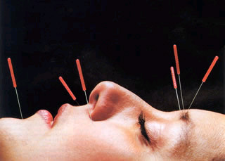
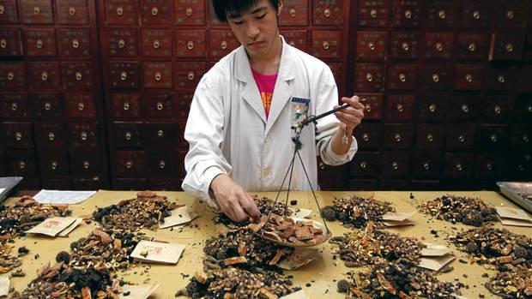
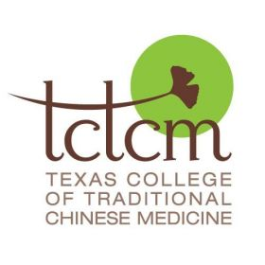
TCM maintains health by:
Use of herbs
Foods
Acupuncture & moxibustion
Physical training

Slide 9
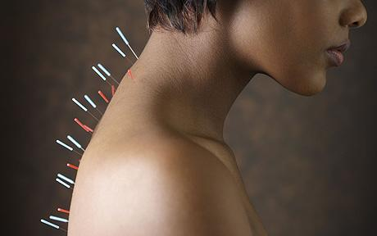
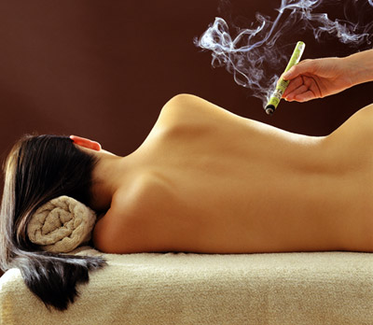
Acupuncture and moxibustion.

Slide 10
You Tube Videos
An Introduction to Traditional Chinese Medicine (8:36)
What does TCM look like? (3:54)
What if someone in Austin wanted to study Chinese medicine? (3:30)
How would a Traditional Chinese Medicine Doctor answer these questions?
How do you treat a cold, headache, backache, injury, allergies?

Slide 11
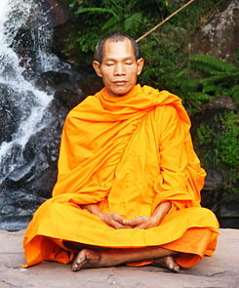
Meditation
Meditation has been practiced since antiquity as a component of most major world religions including Judaism and Christianity.
Some faiths, such as Buddhism, emphasize it as a major component.
In the late 20th century, Western science began to recognize important health benefits to meditation.

Slide 12
Mindfulness Practice
The concept of mindfulness attempts to take advantage of the health benefits of meditation while removing the religious aspects of meditation.
In the United States, many people of all faiths and those without are comfortable with the religious and spiritual aspects of meditation, and do not find them incompatible with their own religious or spiritual beliefs.
However, there are also people in the United States of all faiths and those without who are uncomfortable with religion and spirituality, or may believe that meditation might contradict their own religious beliefs.
Both viewpoints are acceptable and proper. The term mindfulness and its practice attempts to be acceptable to all. It is a focus on health and not religion.

Slide 13
How do you treat stress, ADD, anxiety and/or depression?
According to scientific study, mindfulness could be an answer.
We are seeing an increasing amount of stress, ADD, anxiety and depression in teenagers. Should schools attempt to address this problem with mindfulness training?
Did she convince you? Should schools teach mindfulness?
https://youtu.be/dEzbdLn2bJc

Slide 14
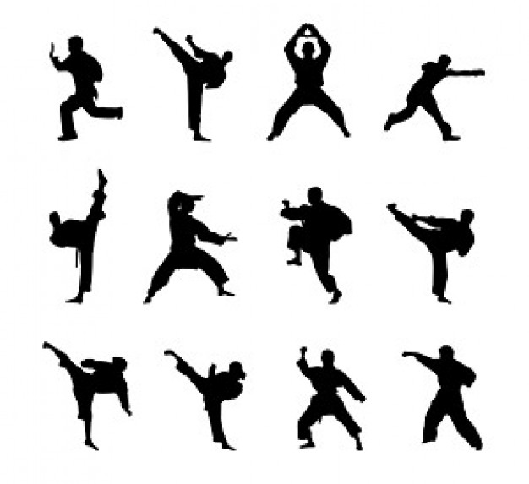
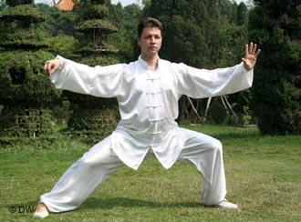
Martial Arts
The art of combat.
Used to train warriors and fighters.
Thousands of different types- in China collectively called kung fu.
Styles that focus on qi cultivation are called internal, while others that concentrate on improving muscle and cardiovascular fitness are called external.

Slide 15
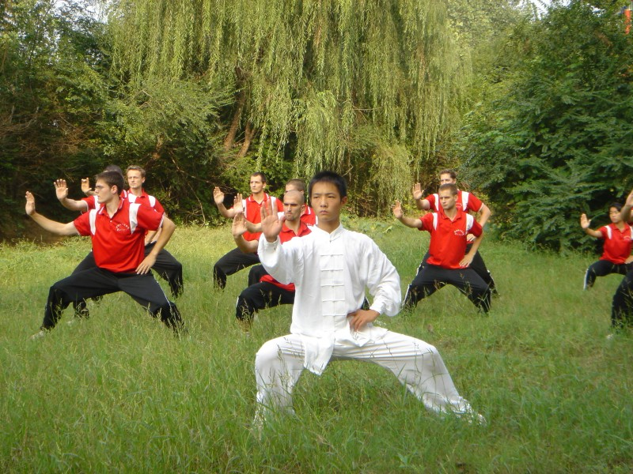
Tai Chi
Originally developed for self-defense, tai chi has evolved into a graceful form of exercise.
Described as meditation in motion, tai chi promotes serenity through gentle, flowing movements.
Involves a series of movements performed in a slow, focused manner and accompanied by deep breathing.

Slide 16
Qi Gong
A practice involving coordinated breathing, movement and awareness.
According to Chinese philosophy, allows access to higher realms of awareness, awakens one’s true nature and helps develop human potential. Video.

Slide 17
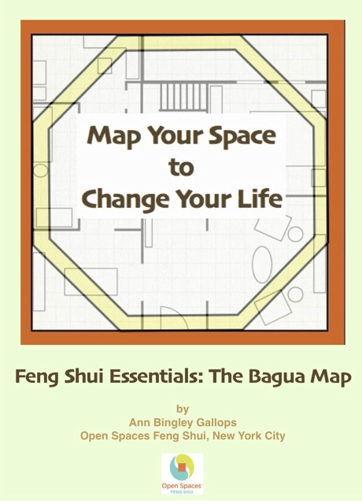
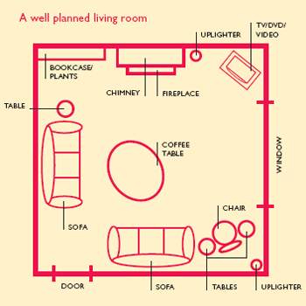
Feng Sui
The placement and arrangement of space to allow qi to flow- can be applied to placement of a building or arrangement of a home. Tips for your home.

Slide 18
Eastern vs. Western
How would you describe Asian medicine? How would you describe western medicine? How do the approaches to health differ?

