Slide 2
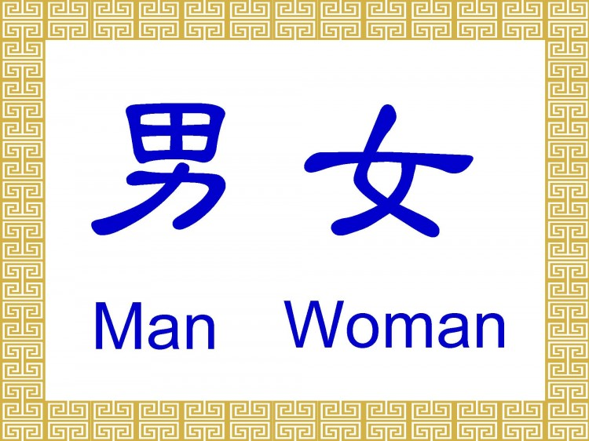
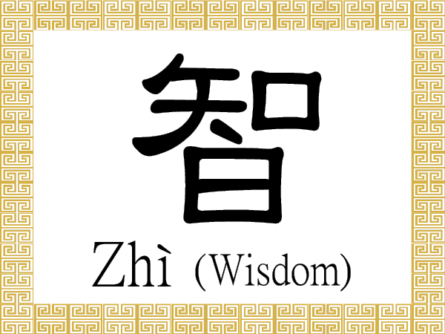
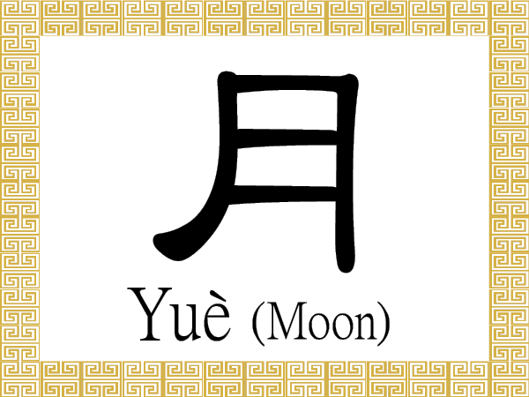
Chinese Writing
Chinese is one of the oldest continually used writing systems still in use.

Slide 3
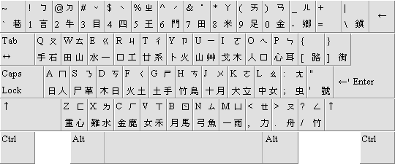
Chinese characters do not constitute an alphabet.
The Cangjie Input Method allows Chinese to be typed on a standard QWRTY keyboard. The method has to be learned separately by Chinese writers. In this method graphical units are represented by 24 basic character components. Using this method, 100 Chinese words a minute can be typed.

Slide 4
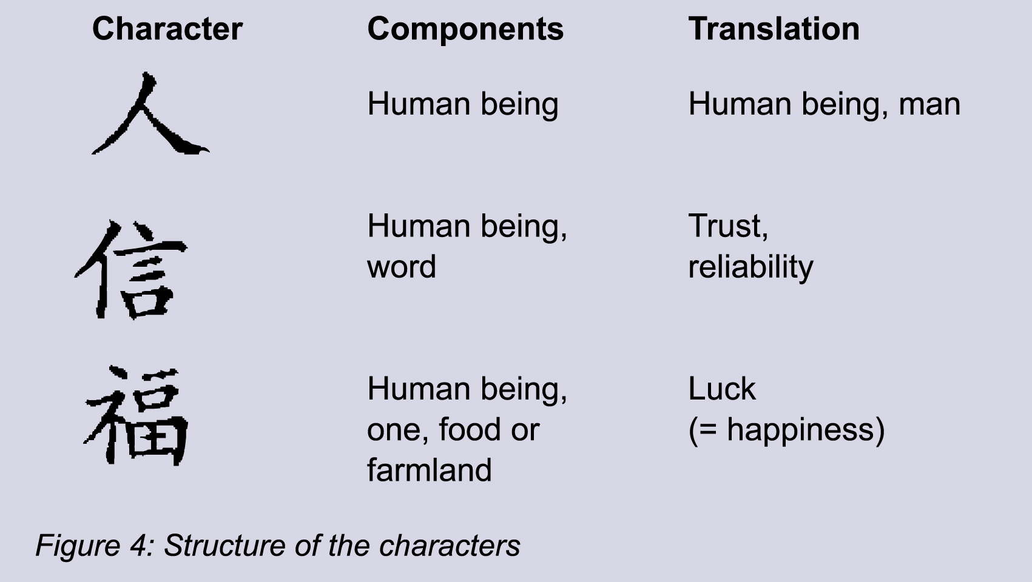
Chinese characters generally represent one syllable of spoken Chinese and may be a word on its own or a part of a polysyllabic word.

Slide 5
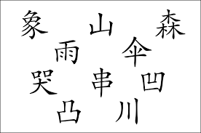
There are tens of thousands of characters and new ones are continually developed.

Slide 6
Chinese literacy requires memorization of characters. Educated Chinese know about 4000 characters.

Slide 7
Chinese characters hugely influenced written Japanese, and to a lesser extent, written Korean and Vietnamese.

Slide 8
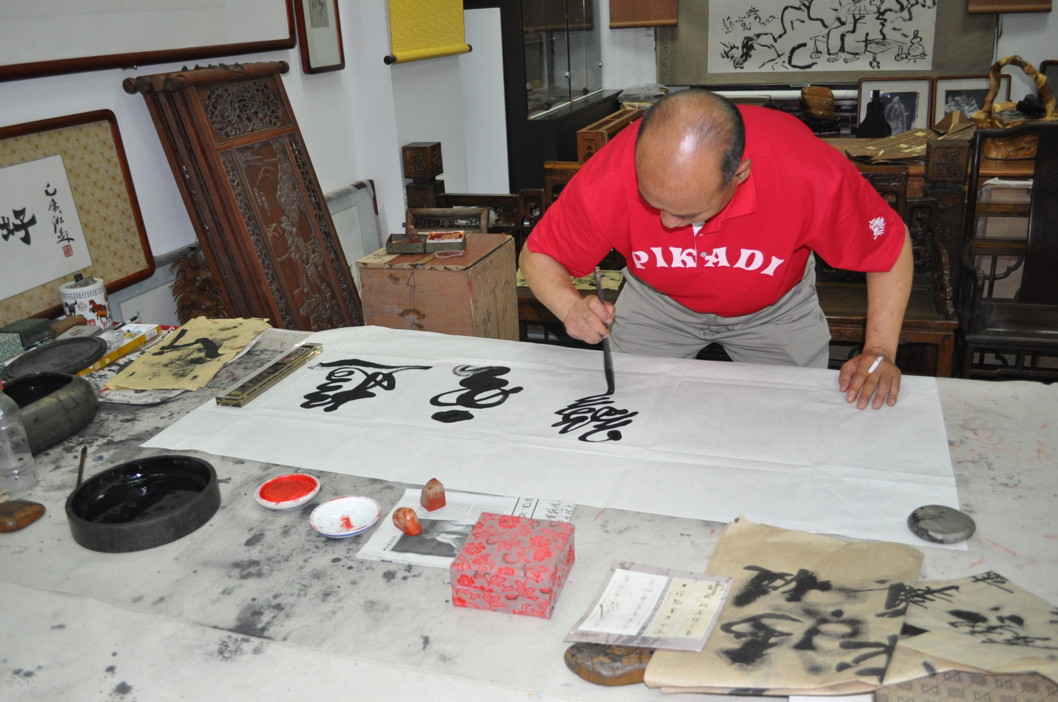
Writing Chinese Characters

Slide 9
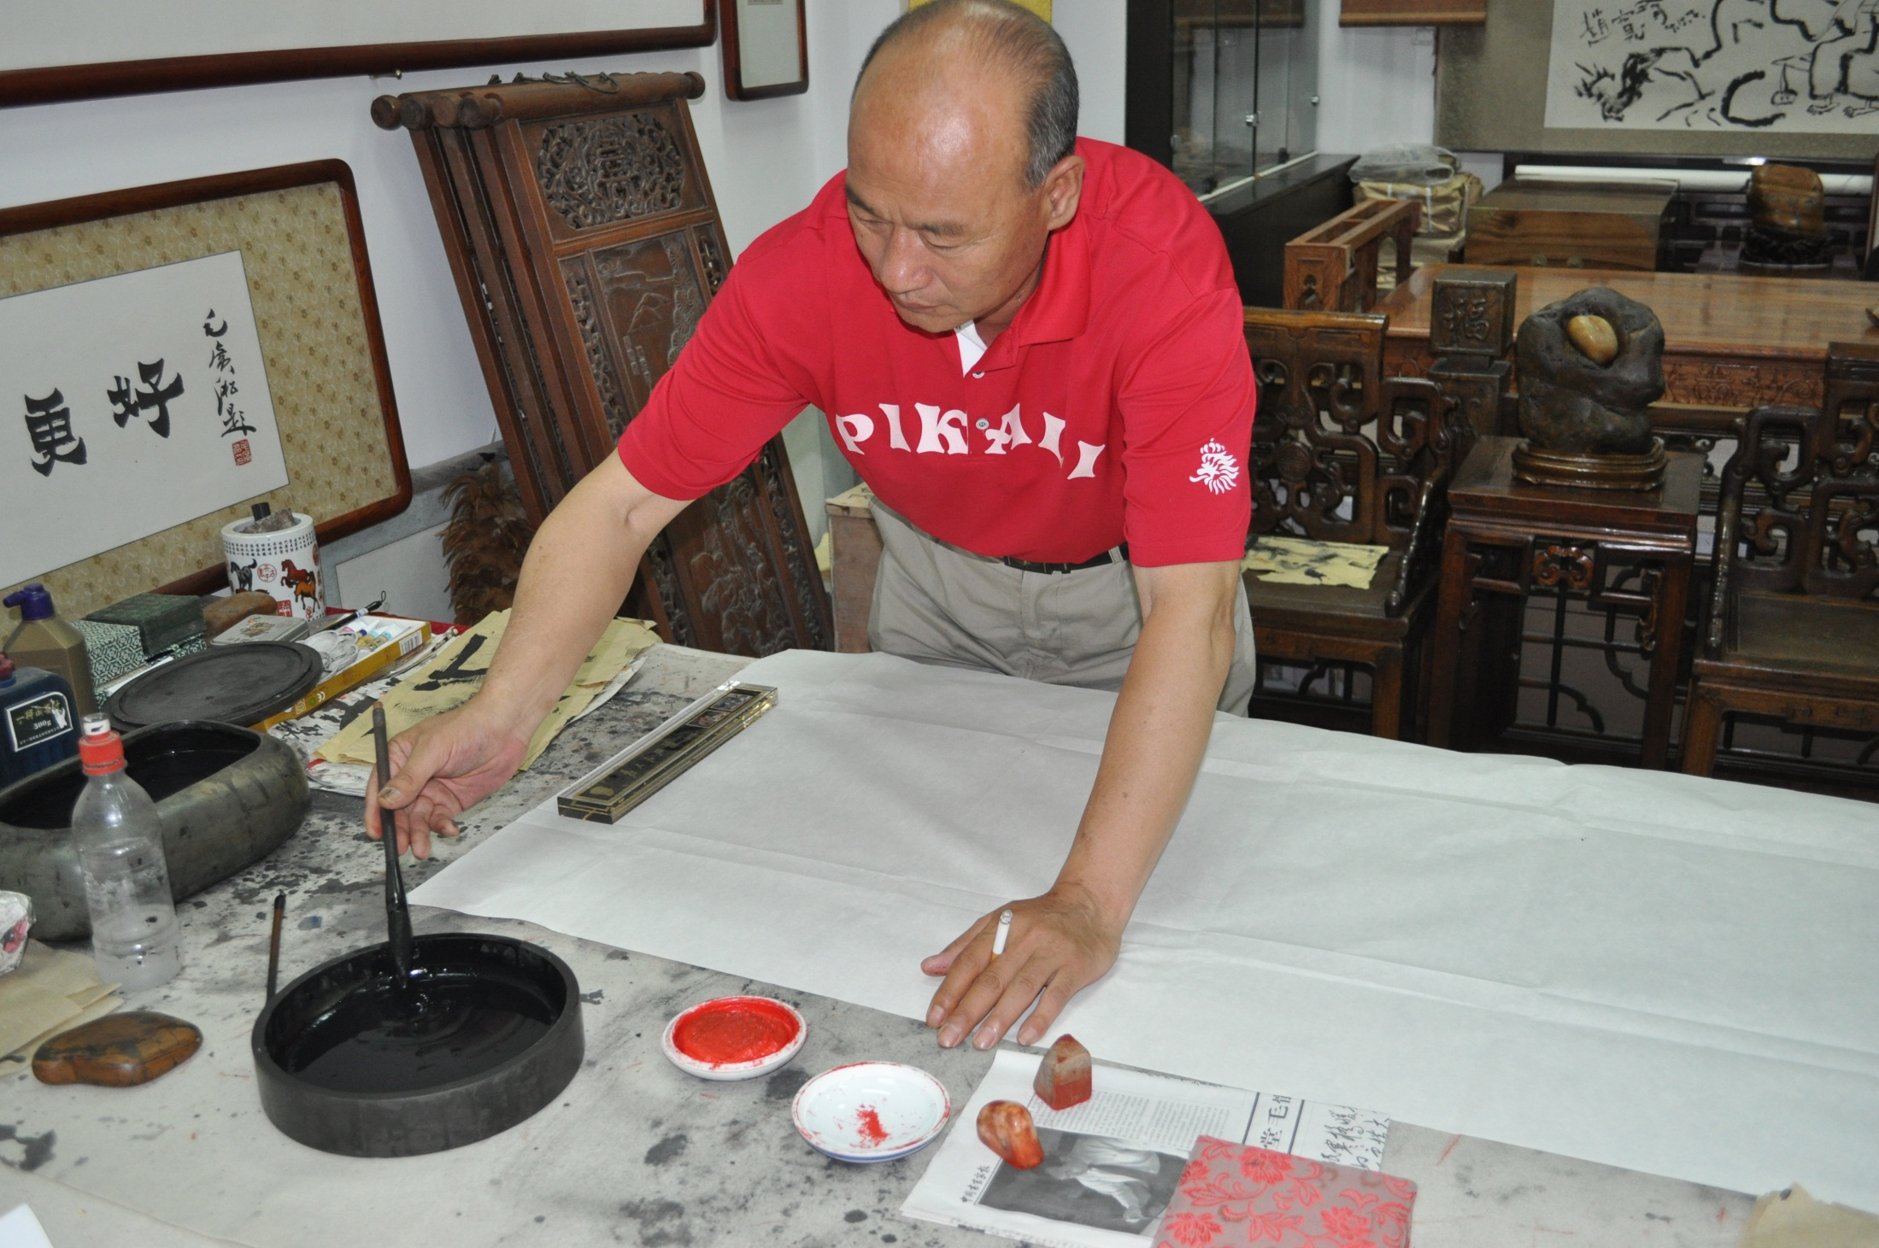

Slide 11
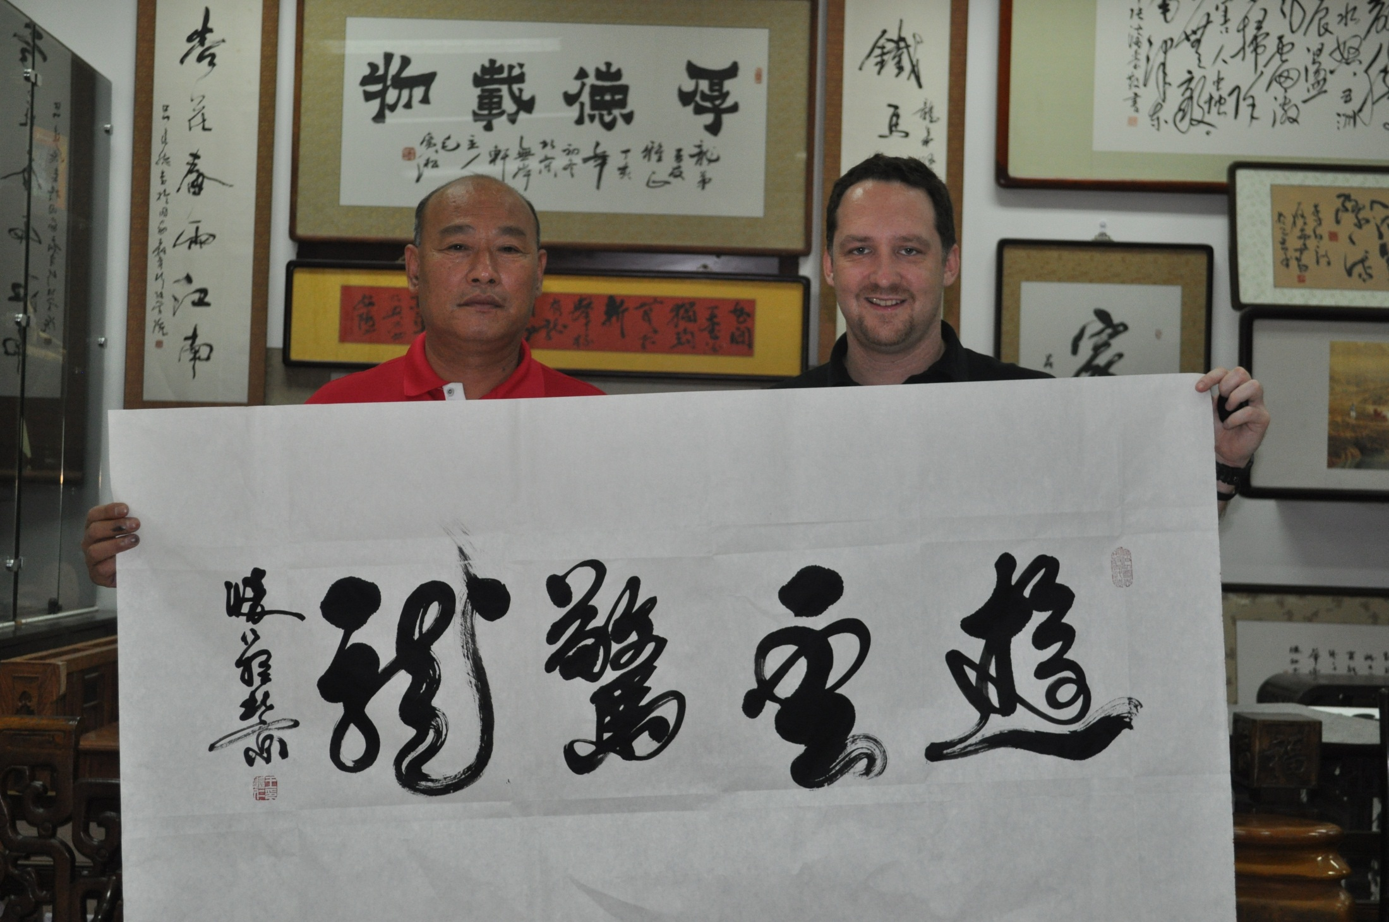

Slide 12
What’s so special about Chinese calligraphy?
What's so special?

Slide 13
Foot Binding:
Cultural Beauty or Cruelty?

Slide 14
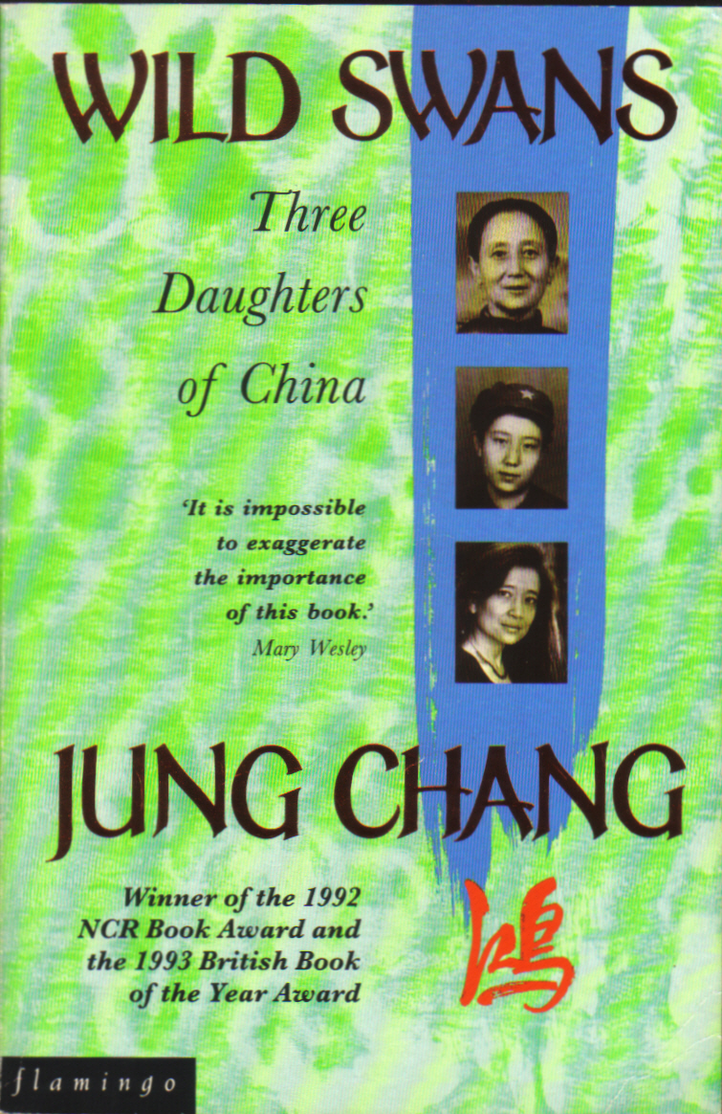

Slide 15
What is it?
This was a custom practiced on females for approximately one thousand years in China.
It began in the 10th century and was made illegal in the early 20th century.
Foot binding was an attempt to stop the growth of the foot.

Slide 16
Foot binding was a status symbol, since only the wealthy could afford to keep women unproductive.
Practiced by all classes in China.
Poor people did so in hopes of improving their social status.
According to legend, women were bound in this way to replicate an imperial concubine who danced with her feet wrapped in silk.

Slide 17
The Process
In China foot binding started between the ages of 4 and 6. Why?
So that the arch did not have much time to develop.
The mother was the one to bind the feet, and usually started the process late in the fall or winter.
Why? - so the foot would be numb and the pain would not be as severe
The daughters' feet would first be soaked in warm water or animal blood and herbs. The special potion that was used for this caused any dead flesh to fall off.
She would have her toe nails cut as short as possible therefore not allowing them to grow into the foot. After she received a foot massage, the four smallest toes on each foot were broken.

Slide 18
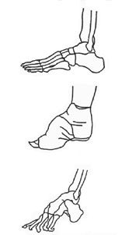
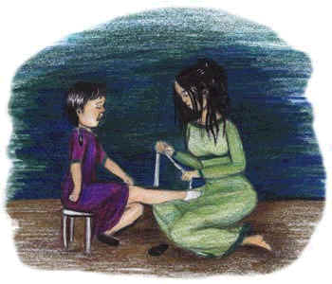
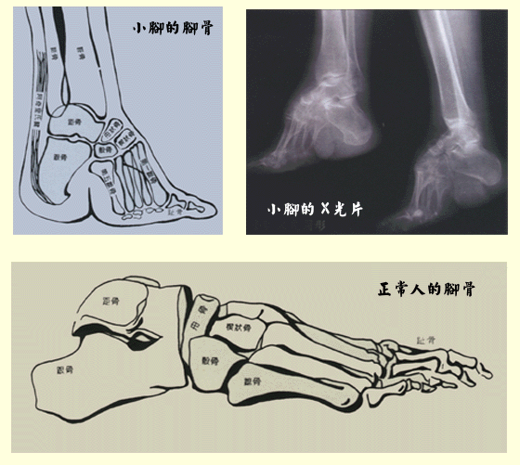
The mother soaked silk or cotton bandages in the same liquid the girl's feet were soaked in. The bandages, which were ten feet long and two inches wide, were wrapped around the smallest toes and pulled tightly to the heel. The toes were doubled under the soles, and deep cuts might be made in the soles to make this easier
Every two days, the binding was removed and rebound. This part of the process went on for two years. The process was very painful; every time the feet were rebound the bandages were pulled tighter.
By this time her feet were three to four inches long. To assure the feet staying small, the ritual continued for at least ten more years
Her heels developed extremely hard calluses because she walked on her heels, unable to put weight on her doubled-under toes.
The ideal was a 3-in. foot, and no longer than 4 in. Bound feet would bend, becoming so concave they were sometimes described as "lotus hooks".
The binding process resulted in intense pain and caused phalanges to fracture easily

Slide 19
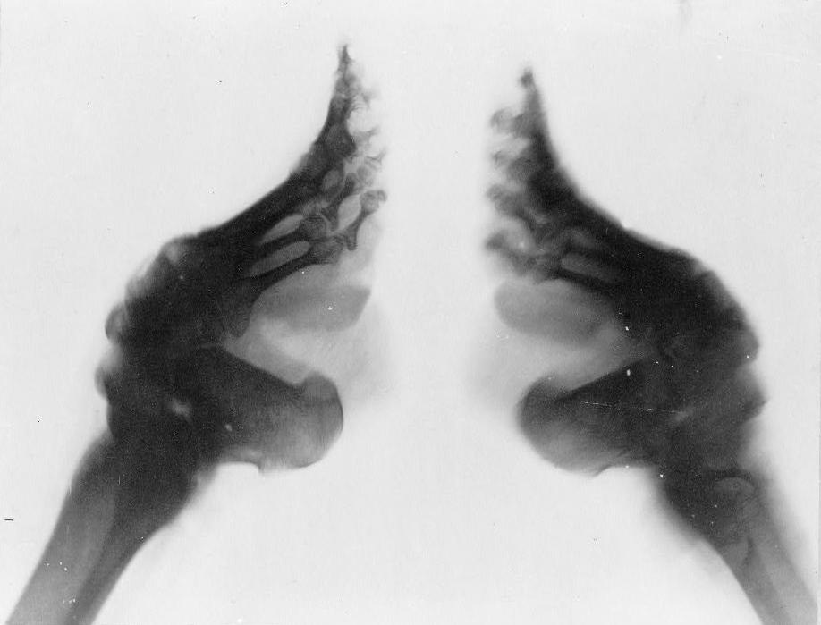
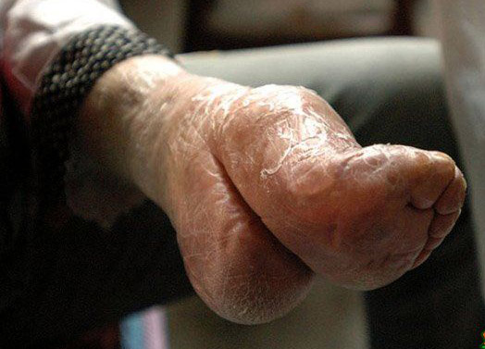
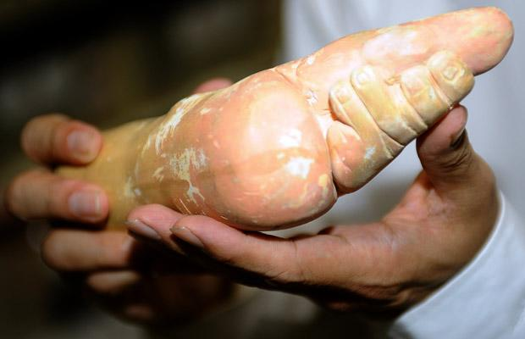
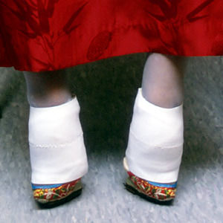

Slide 20
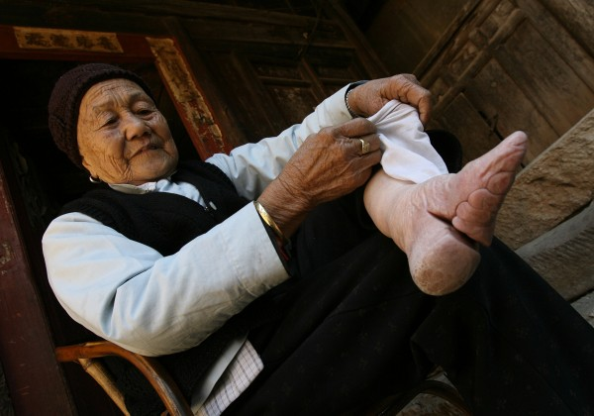
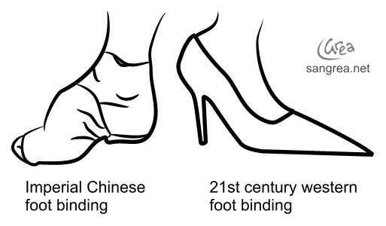
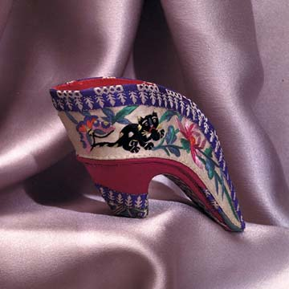

Slide 21
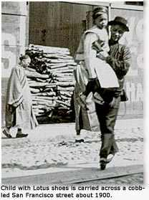
Why?
Men in China in that era would not marry a woman who did not have bound feet. The man's mother was always responsible for making sure the woman he was to marry had bound feet.
If the mother of the man lifted up the woman's dress and discovered "clown feet," she would not allow her son to speak to that woman again. The mother of the man that she loved finding out she does not have bound feet was the most embarrassing thing that could happen to you.
Feet binding also divided men and women and upheld old Chinese beliefs. Foot binding kept women weak, out of power, and dominated by her husband. When women bound their feet, men could dominate more easily and not worry about women taking their power.
The process took place so early, the young girl had no choice but to follow her family's order and have her feet bound. She was seen as an object to the men, to be observed and look pretty, therefore appealing to men mattered more to the girls than their health.

Slide 22
Possible Problems?
As the girl reached adulthood, her feet would remain small and dysfunctional, prone to infection, paralysis, and muscular atrophy.
The pain of the bound feet never stopped.
The toenails continued to grow, eventually curling into the skin. This led to flesh rotting off, and sometimes even a toe.
The feet, being dead, caused a terrible smell the girl carried with her everywhere. Diseases followed infections, and some women died because of the process.

Slide 23
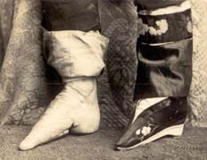
Opposition
Some attempts were made to ban the practice starting in the 17th century, but many defended the system.
In 1912, the Republic of China government banned foot binding; women were told to unwrap their feet lest they be killed.
Some women's feet grew 1/2 - 1 inch after the unwrapping, though some found the new growth process extremely painful and emotionally and culturally devastating.
Foot binding survivors

Slide 24
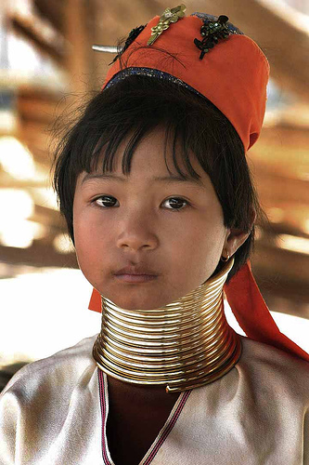
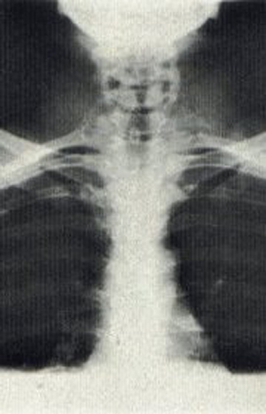
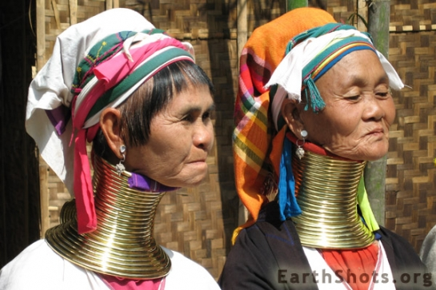
Is this really so unusual though – isn’t it just another instance of women making themselves beautiful through pain? And what about men?
Other cultural modifications:
Neck stretching:
Rings are snapped around the necks of girls beginning at the age of six. A few rings may be added every year, up to a limit of 20. The record, according to one village woman, is 28 brass rings.
The women's necks aren't actually stretched. Rather, the weight of the rings gradually crushes the women's collar bones, producing the illusion of long necks

Slide 25
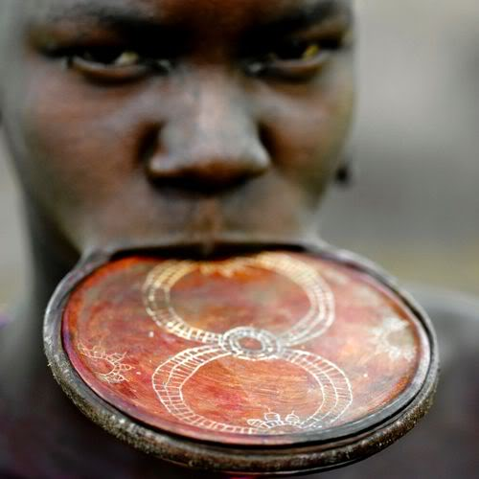
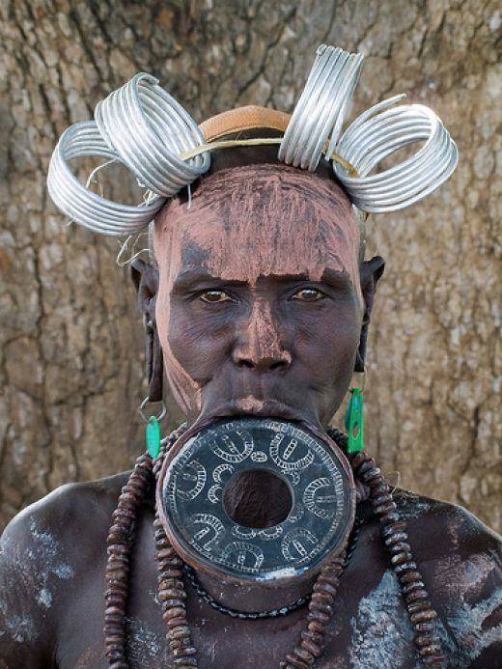
Lip Plates
Six months to a year before a girl is to be married, a small incision is made in the middle of her bottom lip and a stick is put in.
Slowly over time, larger disks are inserted until her lip is stretched big enough to be used for a basketball hoop.
Many girls have their two lower teeth knocked out to accommodate the huge plate causing them to drool and have trouble speaking normally.
The bigger the lip plate, the more physical strife the woman is able to withstand, and the stronger she’ll be as a partner to her husband.
For many women getting a lip plate is the only hope they have for a decent marriage: the bigger the lip, the more desirable a woman is, and the more cattle the groom’s family has to “trade” for him to get a wife.

Slide 26
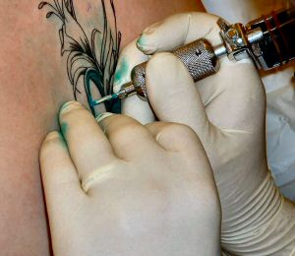
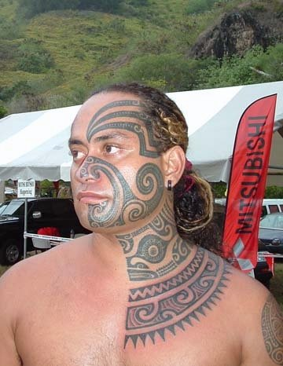
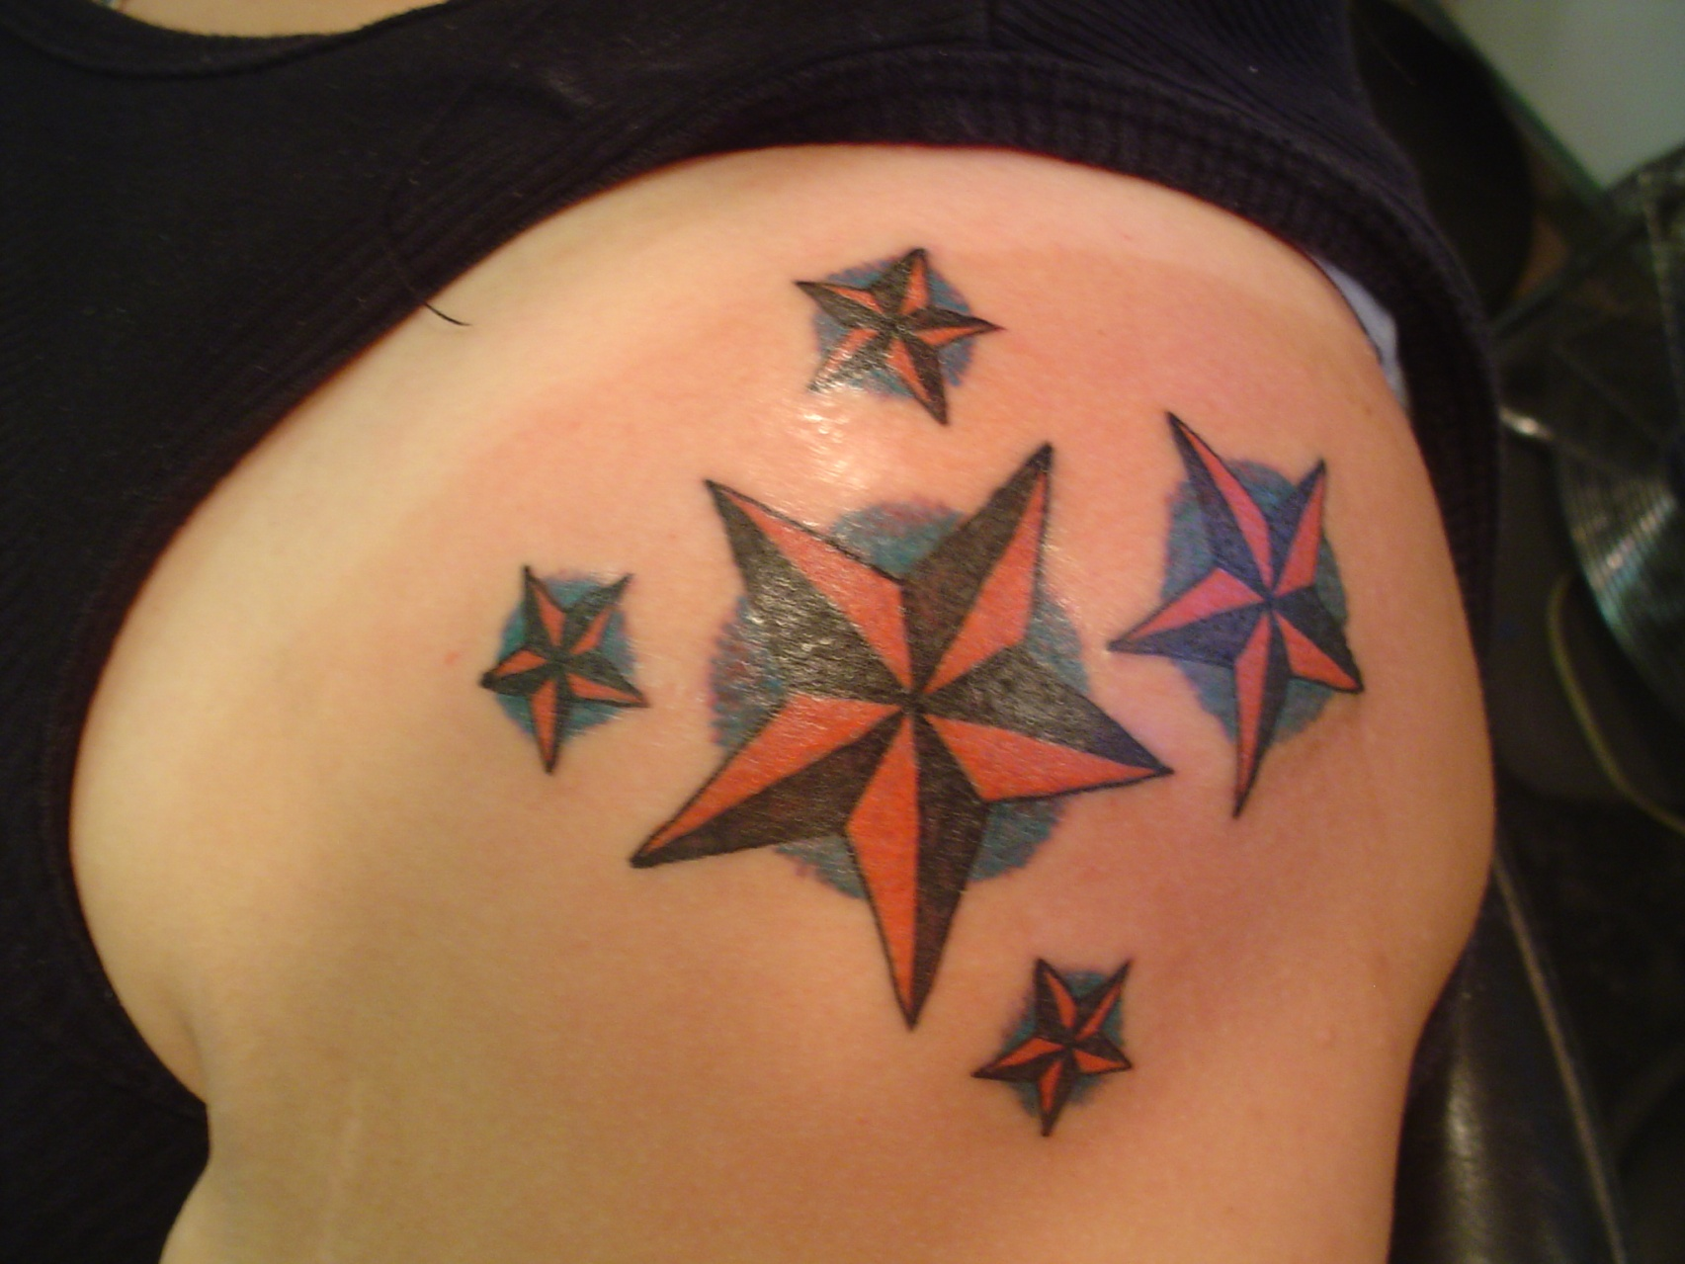
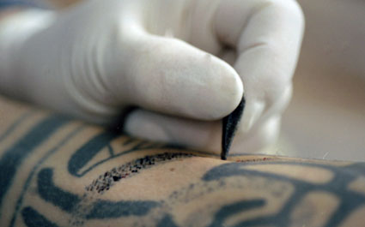
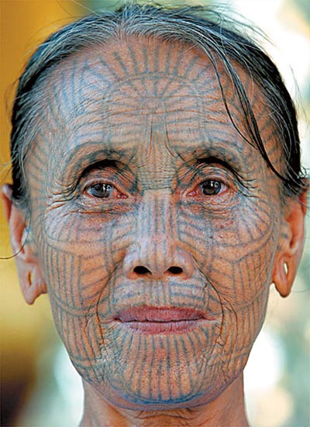
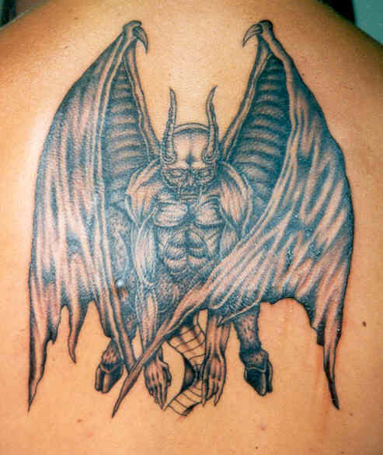
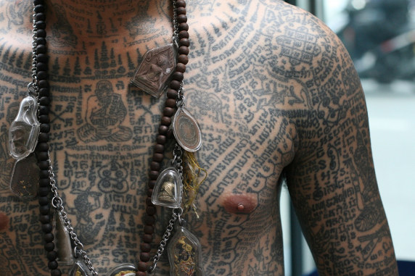
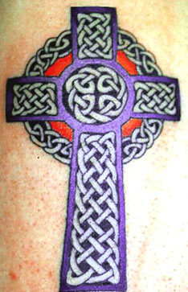
Tattooing
Tattooing has actually been practiced since the time of the ancient Egyptians and is common throughout the world
Tattooing instruments have been found at archaeological digs in Europe that place the time as early as 10,000 BC.

Slide 27
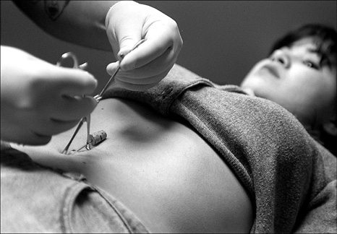
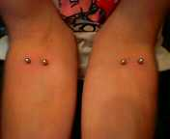
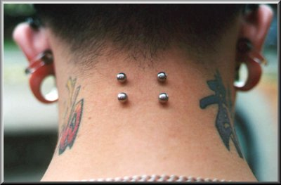
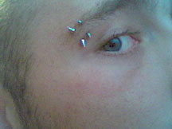
Piercing
the practice of piercing a hole through the skin and inserting a piece of metal, bone, shell, ivory or glass to wear as an ornament has been around for millennia

Slide 28
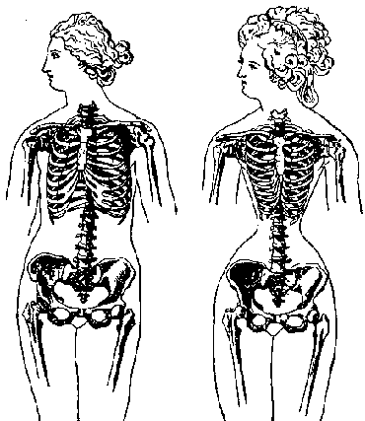
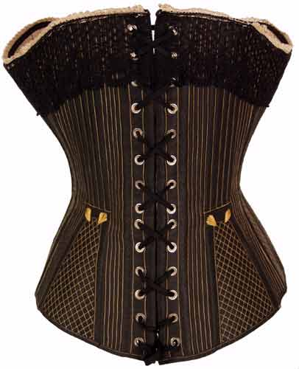
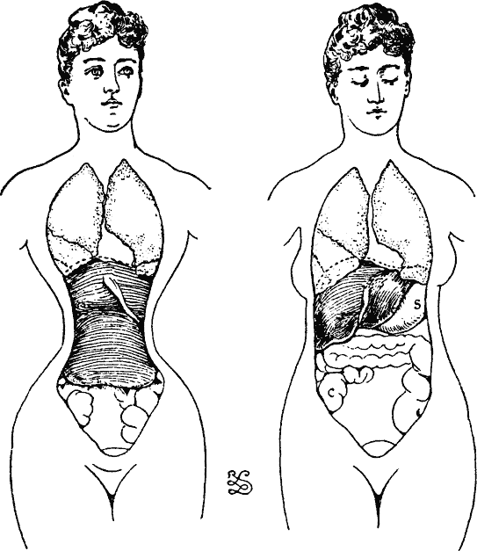
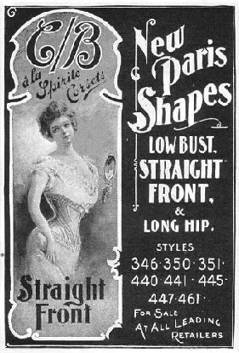
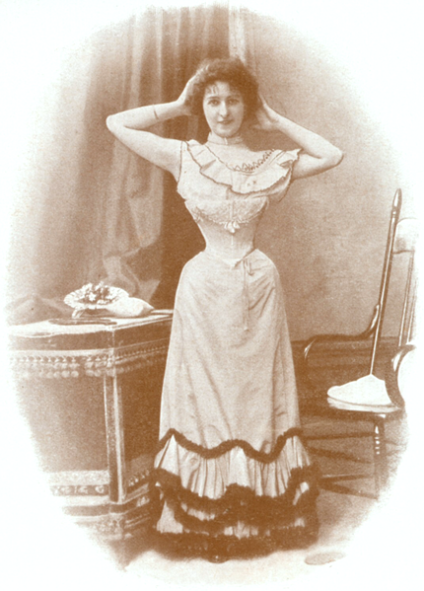
Corsets
As early as 1700 BC, the Minoan men and women wore corsets to pull in the waist.
After years of pulling corsets tighter and tighter, they dislocated internal organs—
constricting the lungs and heart
putting pressure on the liver
pushing up the stomach
squeezing the small intestines and bowels
and compressing the bladder.

Slide 29
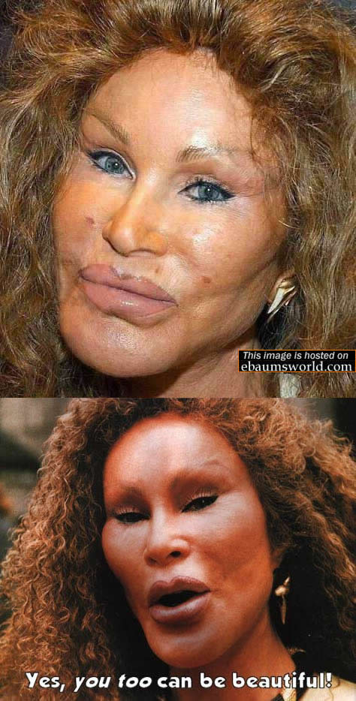
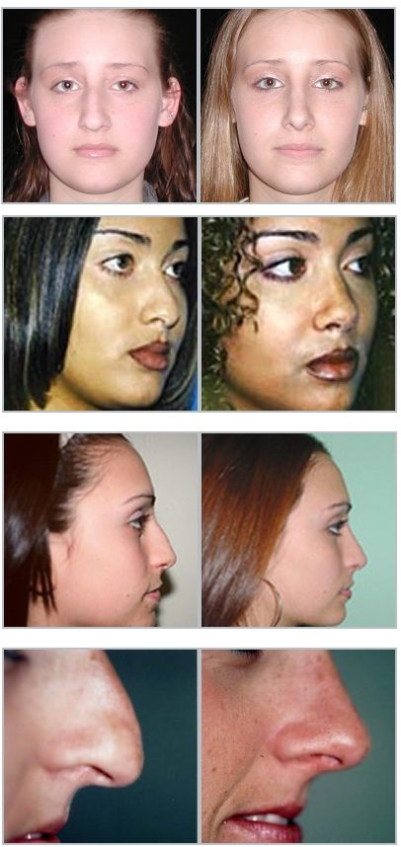
Plastic surgery
Some of these operations are called "cosmetic", and others are called "reconstructive".
The history of plastic surgery reaches back to the 1900's.
Physicians in ancient India were utilizing skin grafts for reconstructive work as early as the 8th century BC.

Slide 30
Others?
Ideas they usually come up with in addition:
Dying, straightening, etc hair
Make up
Scarring
High Heels
Contacts (colored eyes/designs)
Botox
Waxing
Filing

Slide 31
Assignment
"The human body is a canvas for the expression of cultural ideas of men and women throughout time and around the world"
Answer one of the following questions in one paragraph:
1. In your opinion, was foot binding a form of cultural beauty, cruelty to women, or male dominance? (Can be multiple)
2. Compare and contrast foot binding to one or more other forms of body modifications in America.
3. Foot binding was continued till 1957 although it was illegal. Imagine you are a government official and argue your case to either keep it legal or to make it illegal.

Slide 32
Religion in China

Slide 33
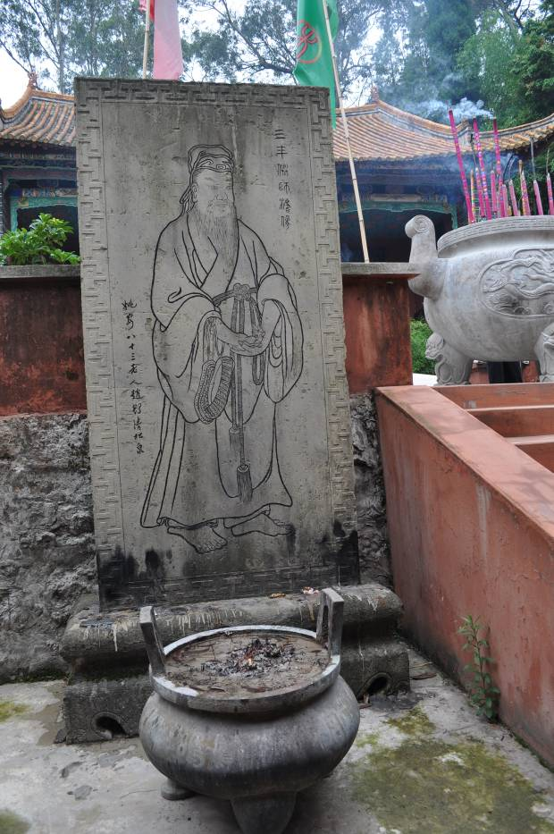
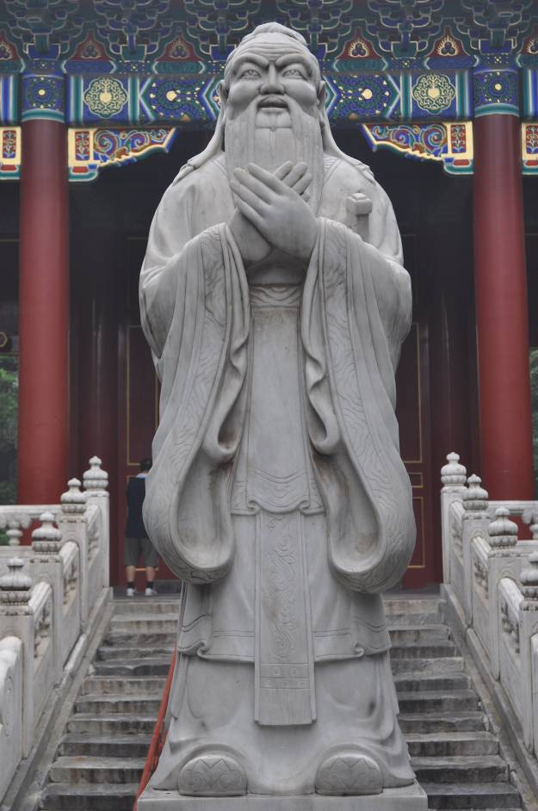
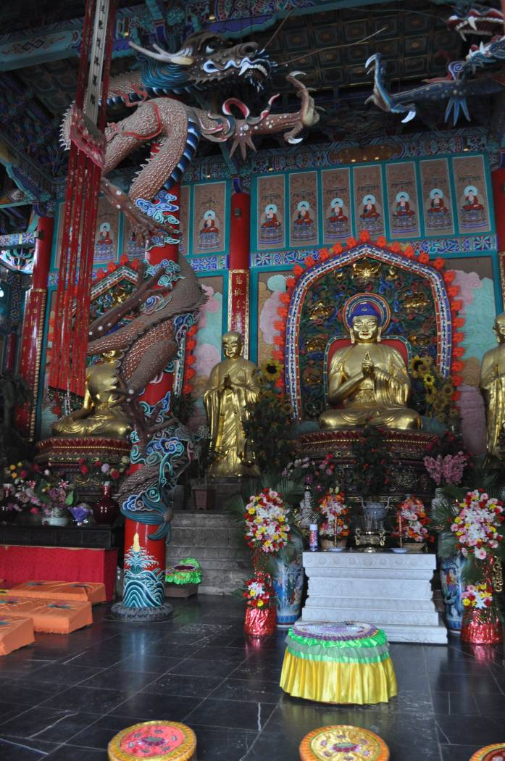
Religion in China
Taoism
Confucianism
Buddhism, 5th Cent. A.D.
According to official statistics, there is no
religion in China, but there is open practicing,
particularly Buddhism.

Slide 34
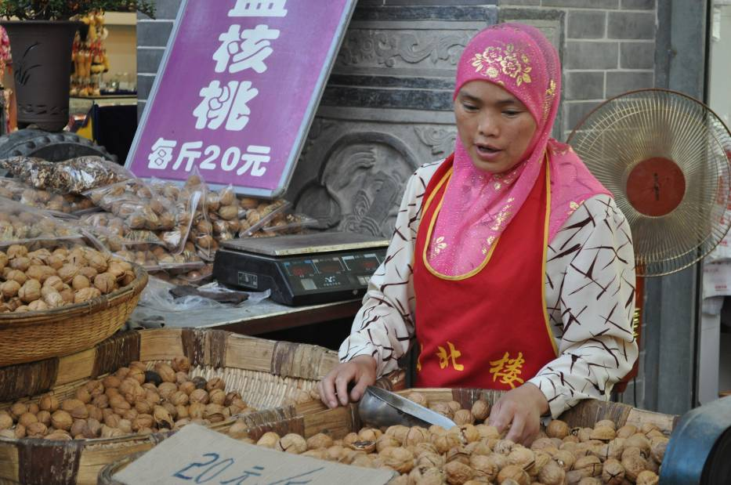
Islam and Christianity are also openly practiced
Islam arrived in the 7th cent. A.D.
This tablet from 781 A.D. describes
the Nestorian branch of
Christianity and mentions its
arrival in 635 A.D.

Slide 35
“I am not religious but I believe in Buddha and I believe in fate.”- Dr. Hu, member of the Communist Party
China has freedom of religion as long as
the religion does not violate the law

Slide 36
Confucianism and Taoism

Slide 37
Taoism and Confucianism Quotes
Explain a quote from Confucianism that speaks to you.
Explain a quote from Taoism that speaks to you.
What do you think are the main points of each philosophy? What are some similarities and differences between Taoism and Confucianism?

